Slide 1
LBBD Pension Fund Committee Training – Triennial Valuation, Investment Strategy and Asset Classes
11 January 2023
David Dickinson, Jesmine Anwar and John Raisin

Slide 2
Agenda:
Introductions
Triennial Valuation
Performance
Asset Types
Strategy Review
ESG

Slide 3

Pension Fund Costs – Triennial Valuation
Triennial Valuation:
Completed every 3 years by the actuary; Determines the employer contribution rate.
Next valuation: 2022, data provided as at 31 March 2022.
Summary of 2022 triennial valuation:
Improved funding position from 90% in 2019 to 103% in 2022 corresponding to a surplus of £33m. Due to strong investment performance and contributions paid plus lower pension increases.
Average primary rates increasing from 19.8% in 2019 to 20.7% in 2022 due to high inflation and a lower net discount rate assumption puts upwards pressure on rates
Increased reporting requirements. Need to value McCloud in line with the proposed benefit changes (as instructed by DLUHC) and consider Climate risks.
2016 Valuation: Liabilities £1,001, Assets £ 772m → Deficit of £228m or 77% funded
2019 Valuation: Liabilities £1,141, Assets £1,022m → Deficit of £119m or 90% funded
2022 Valuation: Liabilities £1,283, Assets £1,306m → Surplus of £33m or 103% funded

Slide 4
Contribution Rates (LBBD)
LGPS guaranteed by Government but employer responsible for shortfall: agreed a plan to close deficit over an 15 year period taking into account:
  Investment returns;
  Life Expectancy;
  Long term government debt yields; and
  Inflation.
Directly impacts LBBD’s budget: staff costs.
Fund is now 103% funded and has improved to 105% funded by 30/11/2022
Council contributions rates: 2016/17 24.5% (from 1 April 2016)
2017/18 to 2019/20 23.5% (from 1 April 2017)
2020/21 21.0% (from 1 April 2020)
2021/22 22.0% (from 1 April 2021)
2022/23 23.0% (from 1 April 2022)
2023/24 to 2025/26 22.0% (from 1 April 2023)
Each percentage change equates to £1.1m so drop from 24.5% to 22.0% is £2.75m less contribution.

Slide 5
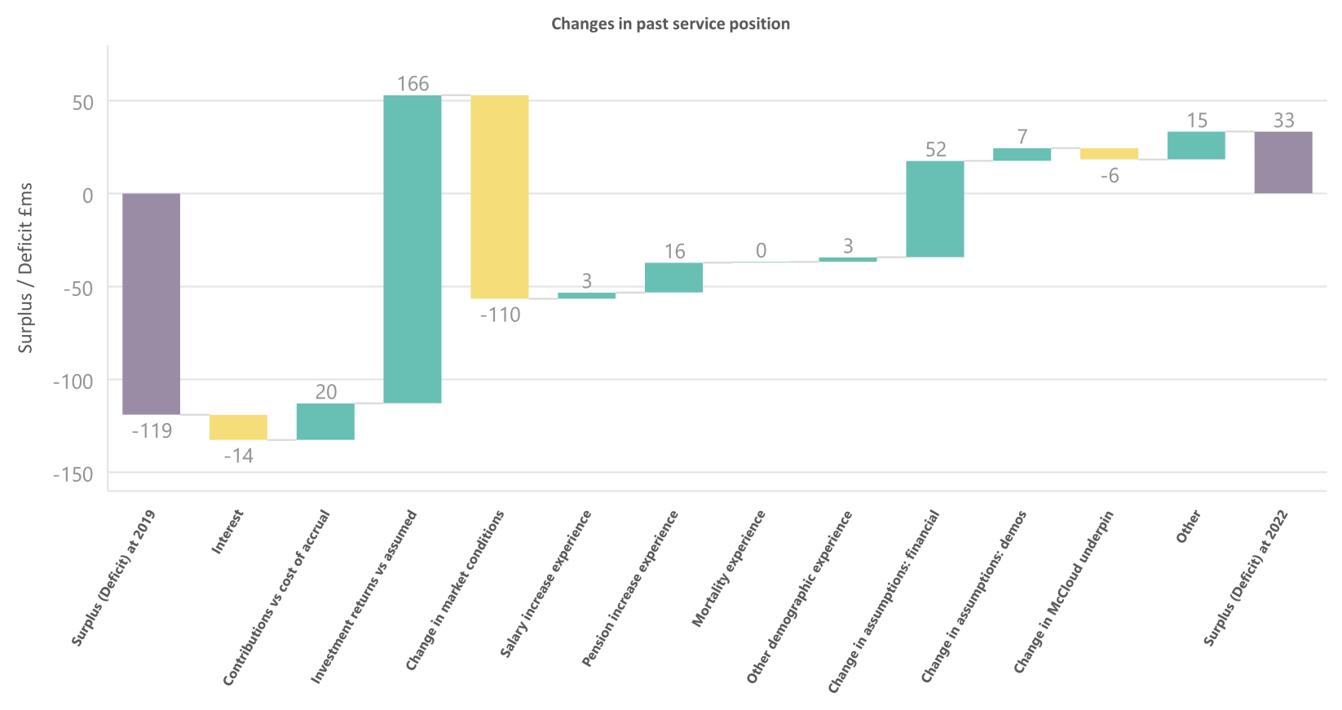
What were the main drivers behind the improved position?

Slide 6
What happens now the Fund is 100% funded
Key is to maintain the funding level at over 100%
Maintain contributions to meet the primary rate (20.7%) for the future service rate
Review the investment strategy:
    What assets and fund managers performed well ?
    Where there opportunities that were missed ?
    Were there threats that were avoided / issues that were avoided?
    Is the asset mix correct – does it need to have less growth, more protection or more passive investments?
  Review Cashflow:
    Fund was cashflows positive in 2021/22 and is currently still cashflow positive.
    Pensions will increase by 10.1%, with salaries increasing by approximately 5% in 2023/24.
    What is required for a small negative cashflow – look at using BlackRock distributions.
    Are there other options if negative cashflow increases?

Slide 7
Pension Investments and Performance 2019-2022
Notes:
Sample title page - one

Slide 8
Asset and Liability Changes - 27/05/2020 to 31/03/2022
Available data only back to 27/5/2020 and shows funding level improvements.
Original actuary was Hymans Robertson but this was changed to Barnett Waddingham.
Asset values peaked in November 2021; dropped steadily but are above liabilities (31/3/2022).

Slide 9
Funding Level Changes - 27/05/2020 to 31/03/2022
Chart shows funding level improve significantly to 31 March 2022.
Hymans Robertson shows more volatility, with Barnett Waddingham approach more smooth.
Both end up at similar values at 31 March 2022 but very different values at other times in the period.

Slide 10
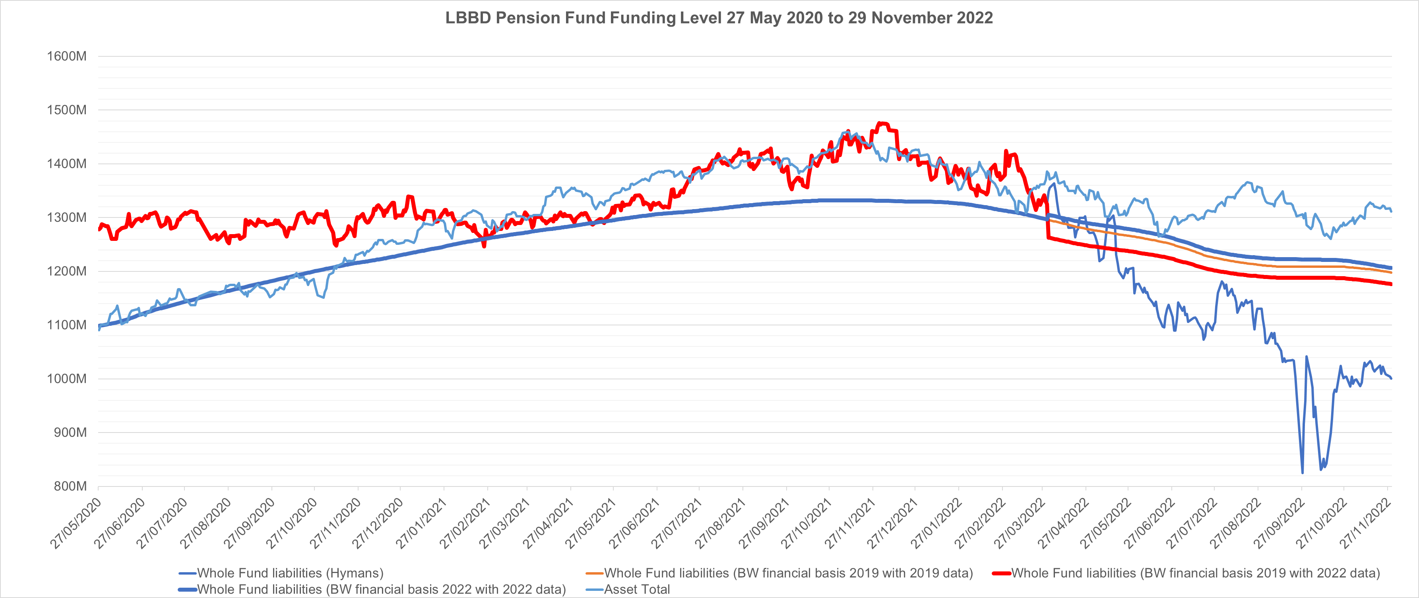
Asset and Liability Changes - 27/05/2020 to 29/11/2022
Data updated to end of November 2022 but with 2022 data added.
Future charts will just contain the latest valuation data.
Issues around gilt yields significantly reduced liabilities based on gilts plus model.

Slide 11
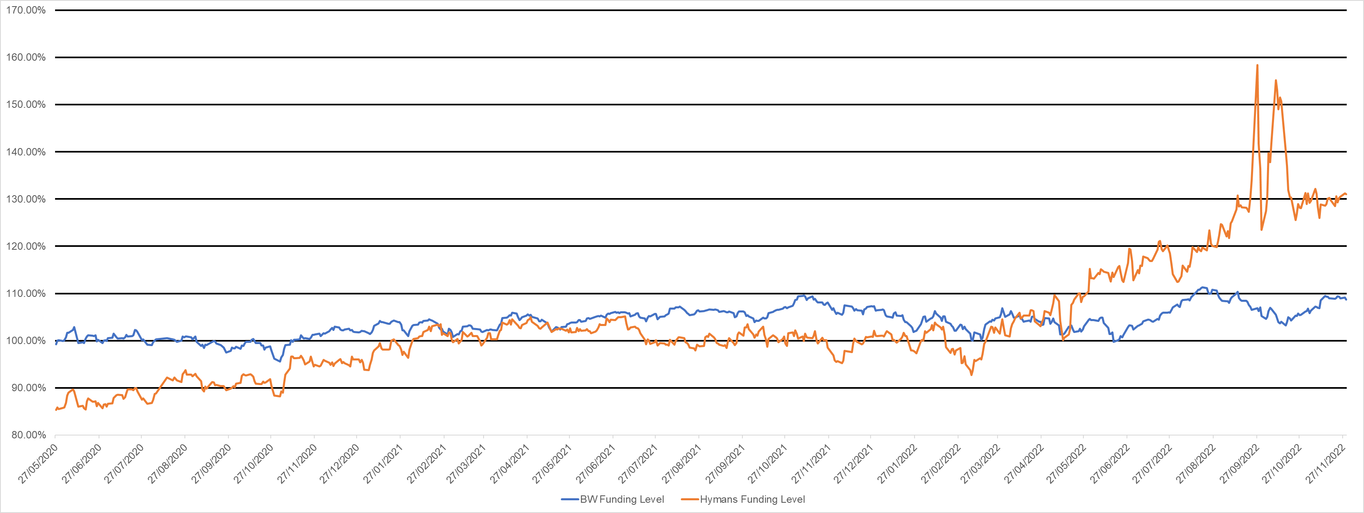
Funding Level Changes - 27/05/2020 to 30/11/2022
Funding level continued to improve to 108.7% for Barnett Waddingham and 131% for Hymans.
For a few days the fund was 158% funded for Hymans and 111% for Barnett Waddingham.
Key factor is Fund’s asset values have been relatively stable and have rebounded from early losses.

Slide 12
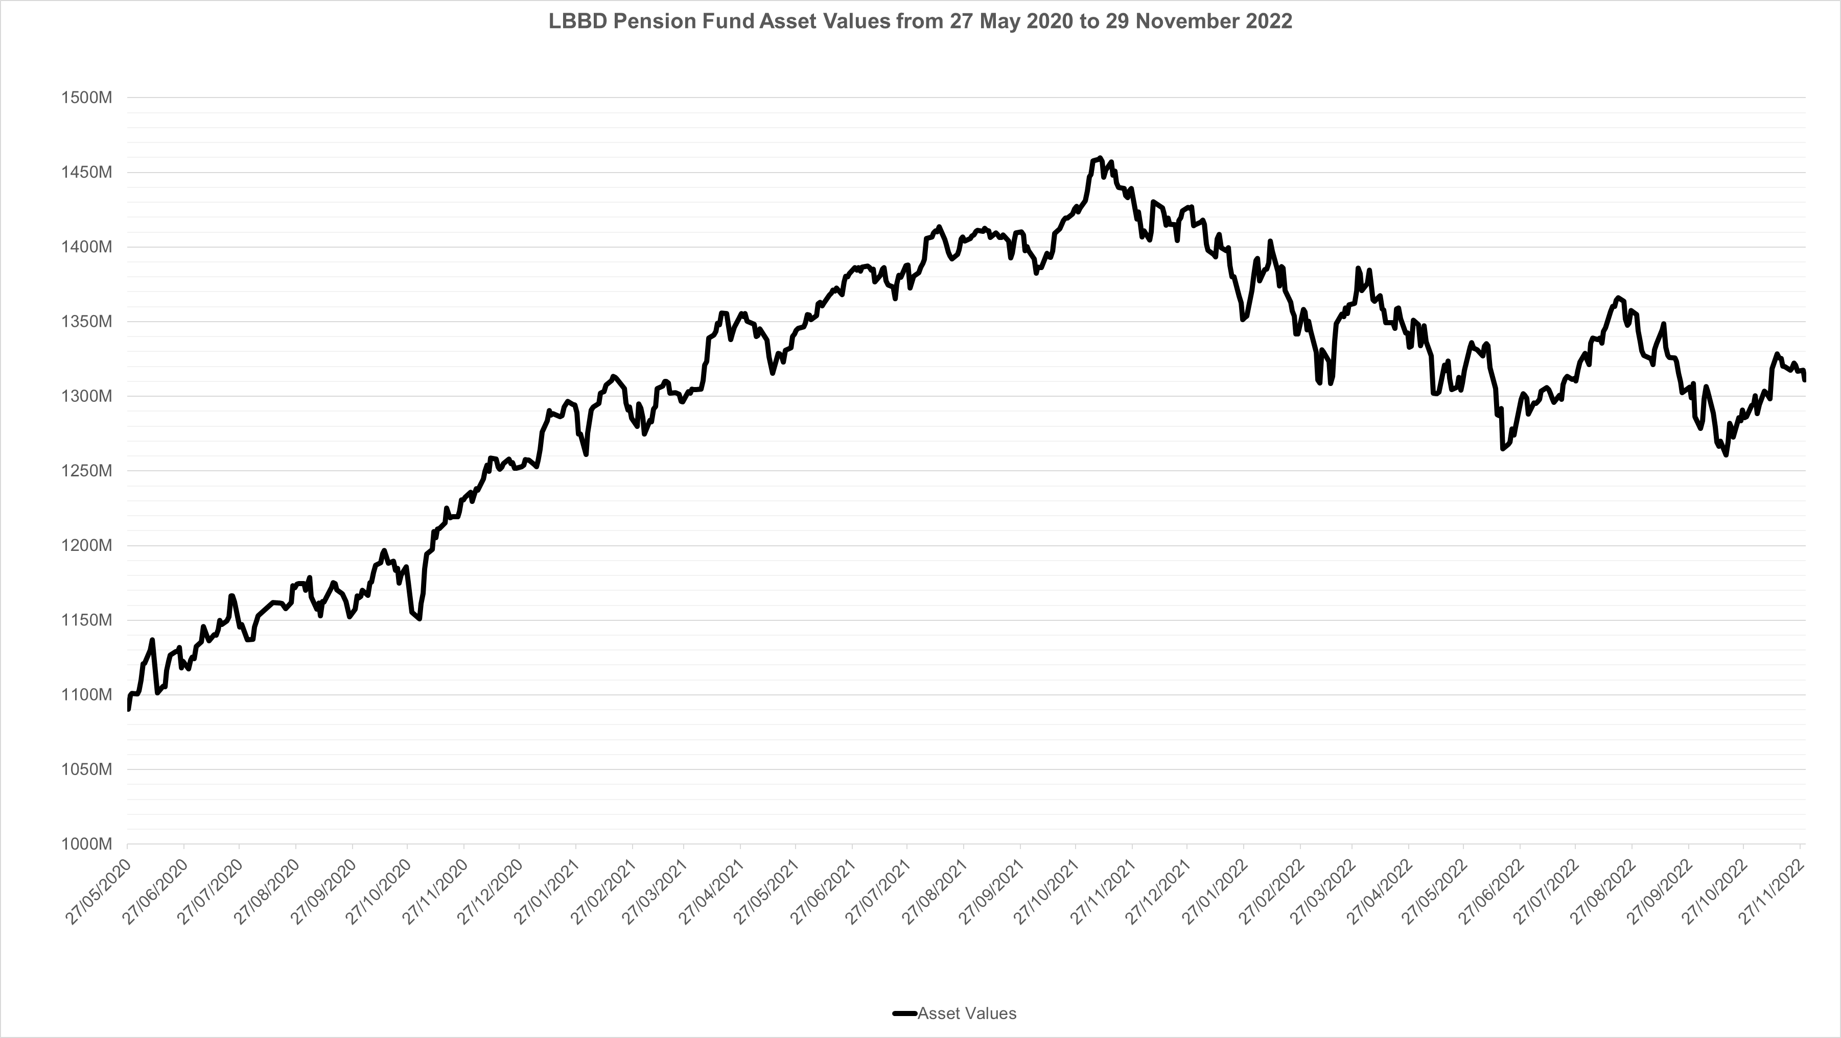
Fund Asset Value- 27/05/2020 to 29/11/2022
Fund value peaked in November 2021 at £1.46bn, with value currently a little over £3.0bn.
Fund was performing exceptionally well but the underperformance by Baillie Gifford has impacted.
Currently there are pressures on property and bonds but Fund has largely missed larger corrections.

Slide 13
Fund Performance 31/03/2019 to 31/03/2022
Overall strategy has provided a good return over a difficult period (Covid, Ukraine, Brexit).
Strategy has underperformed its benchmark over 3 years by 1.3%.
Strategy has outperformed the PIRC benchmark over 3 years by 0.5%.
First two years provided a strong outperformance but the past year an underperformance.
Underperformance due to benchmarks being targets rather than reflecting asset performance.
Review of benchmarks required to ensure shows manager performance against peers.
This may mean having two or even three benchmarks – target, peer and actuary.
Strategy was down 7.5% at 30/9/2022 but has bounced back and is currently flat for 2022/23.

Slide 14
Fund Asset Performance 31/03/2019 to 31/03/2022
Overall strategy outperformed and over a period when liabilities finally started to decrease.
Fund has provided protection from volatility, although protection assets have underperformed.
Equities have experienced a significant correction but the impact as muted by Sterling devaluation.
Assets are largely in-line with Strategic Asset Allocation. Credit and Gilts are underweight.
Private Equity, equities and property are overweight – cash likely to increase in 2023.

Slide 15
Fund Manager Performance 31/03/2019 to 31/03/2022

Slide 16
Asset Classes
Notes:
Sample title page - one

Slide 17



What are investors looking for?

Slide 18
What is a bond?
Key Features
Specified maturity
Coupon
Notional
Primary & secondary markets
Price variability
Bond
Investor
IOU
Bond issuer
Loan
Pension scheme
Insurance company
Sovereign wealth fund
Financial institution
Retail investor
Government Supranational
Corporate
Notes:
17

Slide 19


What is an equity?
Equity is a share in a company - company is owned by shareholders.
Shareholders usually have voting rights and receive dividends.
Equity investors are compensated for extra risk by higher returns.
Share prices rise over time – typically 6% over inflation.
Risk rules of thumb
Bigger stocks tend to be less risky than small ones
More stocks you own, the lower the overall risk but can end up being just Beta (market) returns.
Companies with volatile profits are more risky than those with predictable earnings streams
The more risk a manager takes, the more volatile the performance will be
An average active risk should be broadly twice your performance objective
Notes:
18

Slide 20
A reminder of why to buy equities
Real returns p.a. (1963 – 2020)

Slide 21
Why do share prices rise? - They follow long-term growth
Example – LVMH (Moët Hennessy Louis Vuitton)

Slide 22


Portfolio management: The guardians of your money
Passive or active?
Passive (Beta)
Active (Alpha)
Un-hedged
"At the simplest, an index fund is implemented by purchasing securities in the same proportion as in the stock market index"
Hedged
"Where the manager makes specific investments with the goal of outperforming an investment benchmark"
Notes:
21

Slide 23
The alternatives – the UK experience

Slide 24
An overview of alternatives
Real Estate
Infrastructure
Private Equity
Hedge Funds
Preserves real value
?
?
?
Cash flow
?
Portfolio efficiency
?
Management cost
?
?
?
?
Liquidity
Quarterly
Illiquid
Illiquid
Quarterly

Slide 25
How alternatives can help
Impact on long-term trends – General Example
Traditional only
Diversified strategy
Expected return 7.3% p.a.
Expected risk 11.6%
Expected return 7.2% p.a.
Expected risk 9.2%

Slide 26
Pension Fund Strategy Review - John Raisin
Notes:
Sample title page - one

Slide 27
Strategy Review – Regulatory Background (1)
Each LGPS Fund is responsible for determining its own approach to Investment within the broad framework set down in the LGPS Regulations.
The relevant Regulations are “The Local Government Pension Scheme (Management and Investment of Funds) Regulations 2016.”
Under the 2016 Investment Regulations there are no specified limits on investment in any particular vehicle or asset class. LGPS Funds are expected to determine their own “prudential approach” as set out in their Investment Strategy Statement but it must include a statement of the maximum percentage of the value of all its investments that it will invest in any particular vehicle or asset class.
The Investment Strategy Statement is the document that sets out the Fund’s approach to investment.
In 2016 (revised July 2017) the Government issued “Guidance on Preparing and Maintaining an Investment Strategy Statement” to assist LGPS Funds “with the formulation, publication, and maintenance of their Investment Strategy Statement.”

Slide 28
Strategy Review – Regulatory Background (2)
Under Regulation 7(2) the Investment Strategy statement must include-
a requirement to invest fund money in a wide variety of investments;
the authority’s assessment of the suitability of particular investments and types of investments;
the authority’s approach to risk, including the ways in which risks are to be assessed and managed;
the authority’s approach to pooling investments, including the use of collective investment vehicles and shared services;
the authority’s policy on how social, environmental and corporate governance considerations are taken into account in the selection, non-selection, retention and realisation of investments; and
the authority’s policy on the exercise of the rights (including voting rights) attaching to investments
Regulation 7(3) states “The authority’s investment strategy must set out the maximum percentage of the total value of all investments of fund money that it will invest in particular investments or classes of investment.” – This is commonly referred to as the Strategic Asset Allocation.

Slide 29
Strategic Asset Allocation – characteristics
Types of Assets to be held eg Listed Equities, Bonds, Property etc.
Proportion to be held in each Asset Class.
Overriding principle – must take account of Liabilities .
Investment Strategy must seek to achieve an investment return to meet the Liabilities.
The Strategic Asset Allocation is the SINGLE most important factor determining the returns of an Investment Portfolio.
The selection of Investment Managers is secondary to the selection of the proportion of the Fund to be invested in each Asset Class.

Slide 30
Strategic Asset Allocation – practicalities
100% Funding needed in long term.
Open Defined Benefit Scheme.
Fund is likely to require more income going forward to pay benefits.
Therefore as the LBBD Fund is both an Open Defined Benefit scheme but also likely to need increasing income it needs to invest in both “Growth Assets” and income generative assets.
Refraining from investing sufficiently in “Growth Assets” would require considerably higher employer contributions and therefore these are likely to remain the main focus of the Strategic Asset Allocation.
In preparing its Investment Strategy Statement the LGPS Regulations require a LGPS Fund to take “proper advice” The provider of “proper advice” to the LBBD Fund is Hymans Robertson.
The Pensions Committee determines the Investment Strategy Statement including the Strategic Asset Allocation based on input from the Funds Officers, Investment Consultant (Hymans Robertson), Actuary (Barnett Waddingham) and Independent Advisor (John Raisin Financial Services).

Slide 31
Strategic Asset Allocation – Asset Class examples
Examples of Growth Assets (based on Hymans training February 2022)
Listed Equity
Private Equity
Diversified Growth
Hedge Funds
Property (some)
Examples of Income Assets (based on Hymans training February 2022)
Infrastructure
Property (some)
Investment Grade Corporate Bonds
Alternative Credit

Slide 32
Strategic Asset Allocation - Diversification
Spreading risk across a range of Asset Classes.
Each Asset Class performs differently over time.
Including Asset Classes that increase or decrease to different extents under different market conditions.
Reduce volatility and smooth returns.
Sacrifice some return for more stability?
Include some Asset Classes with clear income generative characteristics.
An appropriate Strategic Asset Allocation should mitigate further Budget pressures on Council and other Employers.

Slide 33
Strategy Review
Proposed Timetable provided below with Investment Strategy Review completed by March 2023;
Strategy review to look at risk and asset allocation and will link this to the London CIV and ESG;
Period | Work items | Notes on deliverables/timescales
Q4 2022 | Review Investment Priorities for 2022/2023 | Discuss with Fund Officers in the first instance and discuss provisional valuation results - December 2022
Q1 2023 | Review of investment beliefs | Investment beliefs survey for the Committee (also covering Responsible Investment)- December 2022
 |  | Training on investment beliefs & discussion of survey results-January 2023
 |  | Draft investment beliefs March Committee meeting- February 2023
 | Responsible Investment wording for ISS | Hymans to provide Responsible Investment section for inclusion in the ISS, to firm up approach to ESG based on beliefs session- January 2023
 | Investment strategy review | Investment strategy review alongside the 2022 actuarial valuation to inform potential adjustments to the level of risk/return and asset allocation. Agree scope of the review with Officers - January 2023, report to March Committee
 | Committee investment training sessions | Hymans to prepare training sessions for Committee alongside strategy review process, covering alternative asset classes (e.g. credit, infrastructure) and Responsible Investment (incl. passive equity)- February
Q2 2023 | Implementation of proposed investment strategy options | Implementation of investment strategy review proposals, including formal recommendations. Consider options via LCIV, look at equity portfolio and review currency hedging process (if required)- April/May
 | Review of ISS | Work with Officers to update ISS as required- May/June

Slide 34
Social, Environmental and Ethical Considerations
ESG Summary
Committed to being a long-term steward of the assets in which it invests and expects this approach to protect and enhance the value of the Fund in the long term.
Recognises that ESG are among the factors which investment managers will take into account, where relevant, when selecting investments for purchase, retention or sale. The Fund requires its investment managers to integrate all material financial factors, including ESG considerations, into the decision-making process for all fund investments.
Expects managers to follow good practice and use their influence as major institutional investors and long-term stewards of capital to promote good practice in the investee companies and markets to which the Fund is exposed. Fund expects its fund managers to integrate material ESG factors within its investment analysis & decision making.
Effective monitoring and identification of these issues can enable engagement with boards and management of investee companies to seek resolution of potential problems at an early stage. Where collaboration is likely to be the most effective mechanism for encouraging issues to be addressed, the Fund expects its investment managers to participate in joint action with other institutional investors as permitted by relevant legal and regulatory codes.
Current Restrictions: restricts direct investment in tobacco but allow indirect investments in tobacco.
Strategy Changes: Fund moved to Paris Aligned Strategy with Baillie Gifford, holds renewables with Hermes.
Engagement: Fund is a member of the LAPFF and in this way joins with other LGPS Funds to magnify its voice and maximise the influence of investors as asset owners. The Fund gives support to shareholder resolutions where these reflect concerns which are shared and represent the Fund interest and joins wider lobbying activities where appropriate opportunities arise.
Reporting: Fund will increase reporting on management engagement, voting and strategies carbon footprint.

