Slide 1
Policy for Handling Member and MP Enquiries
Natalia Monvoisin
Head of Customer Contact
October 2021

Slide 2
Contents
Aims of the Policy
Service Requests and Casework
Service Request Process
Statutory Appeals
Initial Assessment
Members Enquiry Process
Overdue Casework
Current Performance
Areas of Concern and Action
Monitoring Quality

Slide 3
1. Aims of the Policy
To ensure that the council has set out clear procedures to handle enquiries from elected members and Members of Parliament.
To ensure fairness and transparency and that all casework is accurately recorded.
It is recognised that members have a unique role in being a critical link between the council and residents and so a key objective is to make sure members receive prompt responses that address the issues which have been raised.

Slide 4
2. Service Requests and Casework
Members maybe approached by a resident for many reasons, but we make a clear distinction between:
How do we define a service request?
A service request is defined as a report which in the first instance does not require a formal response. These requests can be from a Member on behalf of a resident for a new bin, pothole fix or fly tip etc.
What is casework?
Casework will relate to ongoing issues for which a resolution has not been found. An example of this would be 6 missed bin collections in an 8-week period which would indicate a specific issue with the address.
The Customer Feedback Team provides support to our members in logging cases in which there is clear consent from the resident.
If consent is not clear, the Customer Feedback Team will write back to the member and request that further information is provided to prove consent.
Notes:
(Where the member requests information involving personal data (either for their own use or on behalf of a constituent) the Council will ensure that the request is handled in compliance with the Data Protection Act 1998 (superseded by the General Data Protection Regulations) and the Council policy on Information sharing. The full Council’s data privacy policy can be found here: https://www.lbbd.gov.uk/general-privacy-notice

Slide 5
3. Service Request Process
Log into My B&D (you will be able to see the progress and send chases via My B&D without having to email the service)
The service request will be logged onto the relevant back office system for the service to action
If the SLA has passed you can send a chase via My B&D without having to email the service
Acknowledgement email sent from the back office system sating the SLA with a reference number
If the service request has not been fulfilled or completed as stated this can be raised as a Members enquiry *
*Raising members enquiries A Members enquiry should only be raised for a failed service request if: 1. No response has been obtained from the service within 28 days of logging and you have chased at least once
2. The service request was deemed as complete on My B&D but evidence shows that it was not (e.g. fly tip not cleared)
3. Ongoing issues for which a resolution has not been found. (e.g. 6 missed bin collections in a 8 week period which would indicate a specific issue with the address.)
We recommend using My B&D for the following service requests:
report environmental health or waste issues such as fly-tipping
report a missed bin collection or requesting a bulky waste collection
As you can track and chase requests without having to email the service through My B&D
We can use the data to track how services are performing and use to reinforce good practices and work on improvements

Slide 6
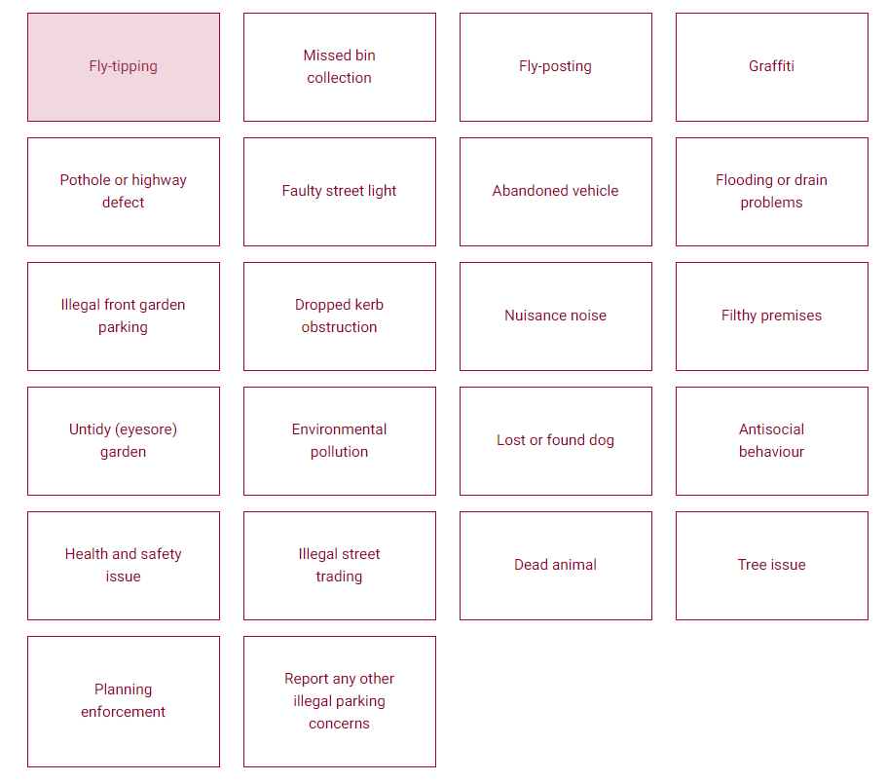
Service Requests (using Report it)
To support customers and Members we have other reporting functions other than My B&D
Report it via website https://www.lbbd.gov.uk/report-it
(each form will state, an SLA once submitted, and information is contained on each tile before you submit)
Resident Housing Repairs(non-emergency) https://www.lbbd.gov.uk/council-house-repairs
The platforms enables both customers and members to report issues directly
*Please see Appendix 1 for more detail

Slide 7
4. Statutory Appeals
By law, service users have the right of appeal against decisions taken by the Council in certain cases.
These may include planning appeals, parking appeals, admission appeals, exclusion appeals, review of a decision regarding homelessness and the review of a decision for award of council tax or housing benefit.
Should the matter be referred to the appeal route the Customer Feedback Team will inform the member directly of the route of appeal and how this can be accessed.
Should the matter be referred to appeal this would then fall outside of the casework process and as such no formal response will be provided.

Slide 8
5. Initial Assessment
Officers will assess the enquiry to determine whether it constitutes an appeal, a service request, a complaint, or an information request and decide whether the matter should be formally logged and processed as Member Casework.
An enquiry will be processed as Member Casework where the elected Member has identified that something clearly needs to be addressed and has the consent to receive the relevant information requested.
The Customer Feedback Team upon receiving the request for information can place the enquiry through the complaints process if deemed necessary.
An example of a case which can be taken as a complaint rather than casework could be a repairs issue which has been ongoing for an extended period with the resolution not being apparent. In these cases, the complaints procedure provides the option for the resident to formally follow through to the relevant Ombudsman.
Should the matter be referred to the complaints process the member will receive a copy of any response sent. The two processes will remain separate and will not run at the same time.
On the occasion when we receive casework which falls outside of the remit of the Local Authority, the Team will endeavor to provide to the member the third-party organisation who will be able to assist with the enquiry.
An example of a case which we would be unable to assist in would be if the resident was a tenant of a Housing Association and required a move. The Local Authority would have no capability to assist in any move as this would not be within our remit. Other such third parties can include Health Services and Transport for London.

Slide 9
6. Members Enquiry Process
On Day 10 if the investigation is going to take longer than thought the Customer Feedback Team will contact the Member directly with a revised date
Within 24 hours
Within 10 days
Contact members.feedback@lbbd.gov.uk or call x8989
Logged within 24 hrs
Email response sent addressed to Member with resolution
Acknowledgement sent to the member within the same 24 hrs
Cases will be closed once the response has been sent
Notes:
Quality of responses do fall short on occasions – we acknowledge this and basic responses such as an enforcement officer will visit is not sufficient - we acknowledge this and are working on how we can ensure more robustness around this.

Slide 10
7. Overdue Casework
Following the 10 day period further chases are undertaken on a regular basis by the Feedback Team to ensure that cases remain a priority to close.
Weekly Reports on a Monday are sent to all Directors so that they are aware of any case which goes over the due date. It is the expectation that Directors will monitor the open cases list to ensure teams are closing cases.
Monday morning a report is produced for both the Chief Executive and Deputy Chief Executive which is also sent to all Heads of Service who have teams who appear on the overdue report.

Slide 11
8. Current Performance
We have noted since the beginning of the year a steady increase of both complaints and members. This increase is placing additional pressure on services which were already struggling to maintain the performance.
A large increase of 20% in casework received is reported between quarter 1 and 2. With 82% of casework answered within timescale.
August saw a sharp drop in response and volume which could be attributable to holiday season.
We have failed to hit our SLA for complaints and members so far this year.

Slide 12
9. Areas of Concern & Action
The following services have been identified as performing below corporate Complaints/Member standard levels for more than 2 quarters:
Public Realm (My Place)
Enforcement, Parking (Core)
BD Group
The top 2 areas Public Realm and Enforcement (Parking) will need to produce an action plan to present at CPG in November. This plan will be reviewed and monitored via CIB (Customer Information Board) and then performance improvement reported back into CPG in January. (we will continue this cycle of accountability).
The BD Group remains accountable to various boards in particular IG and will report their action plan and improvements via this route.
Members Casework Received
 | Quarter 1 | Quarter 2
BD Group | 98 | 94
Be First | 35 | 43
Community Solutions | 209 | 246
Core Services | 367 | 428
Inclusive Growth | 4 | 4
My Place | 264 | 385
Total | 977 | 1,200

Slide 13
10. Monitoring Quality
Currently service blocks are accountable for self-auditing their responses (we provided a self-audit tool to do this).
We have acknowledged that this is not working as some responses are still falling short of a reasonable standard.
Current resourcing challenges in the Customer Feedback Team has meant that quality monitoring sampling has not been as robust as in previous quarters.
The Customer Feedback Team are looking to re-introduce the Complaints/Enquiries Quality Forum.
We will leverage the above as part of the Customer Information Board and can start a quarterly report in line with the performance data we review.

Slide 14
Appendix 1 Reported via e-forms
WASTE & ENFORCEMENT
Report dumped rubbish (fly-tipping)
Report noise
Smoke and smells nuisance
Report eyesore (untidy) garden
Report illegal front garden parking
Report filthy and verminous property
Report suspected food poisoning
Report abandoned vehicles
Report fly-posting (unauthorised stickers and posters)
Complain about trading standards
Missed domestic and recycling bin collection
Missed garden waste collection
Request a new or replacement bin
Report illegal street trading and car sales
Report a lost or found dog
Report graffiti
COMSOL
Antisocial behaviour - ASB
Community trigger -follow up form after ASB
HOUSING BENEFIT
Explanations, reviews and appeals
Pupil premium registration (free school meals)
Discretionary housing payments for moving costs
General enquiries
DHP for Universal Credit
COUNCIL TAX
Propose an arrangement
ENVIROMENTAL HEALTH
Report environmental pollution
Complain about food quality or a food premises
HOUSING RENT
Request for bar-coded letter
Housing Cost Element
Request permission to discuss a rent account
Rent enquiry
TREES / PARK
Report trees
Report storms
HOUSING REPAIRS
Ability to book non-urgent housing repairs

