Slide 1
Aims of the Policy
To ensure that the council has set out clear procedures to handle enquiries from elected members and Members of Parliament.
To ensure fairness and transparency and that all casework is accurately recorded.
It is recognised that members have a unique role in being a critical link between the council and residents and so a key objective is to make sure members receive prompt responses that address the issues which have been raised.

Slide 2
Service Requests & Enquiries
How do we define a service request?
A service request is defined as a report which in the first instance does not require a formal response. These requests can be from a Member on behalf of a resident for a new bin, pot hole fix or fly tip.
What is casework?
Casework will relate to ongoing issues for which a resolution has not been found. An example of this would be 6 missed bin collections in a 8 week period which would indicate a specific issue with the address.

Slide 3
Members Enquiry Process
On Day 10 if the investigation is going to take longer than thought the Customer Feedback Team will contact the Member directly with a revised date
Within 24 hours
Within 10 days
Contact members.feedback@lbbd.gov.uk or call x8989
Logged within 24 hrs
Email response sent addressed to Member with resolution
Acknowledgement sent to the member within the same 24 hrs
Cases will be closed once the response has been sent

Slide 4
Service Request Process (using My B&D)
Log into My B&D (you will be able to see the progress and send chases via My B&D without having to email the service)
The service request will be logged onto the relevant back office system for the service to action
If the SLA has passed you can send a chase via My B&D without having to email the service
Acknowledgement email sent from the back office system sating the SLA with a reference number
If the service request has not been fulfilled or completed as stated this can be raised as a Members enquiry *
*Raising members enquiries A Members enquiry should only be raised for a failed service request if: 1. No response has been obtained from the service within 28 days of logging and you have chased at least once
2. The service request was deemed as complete on My B&D but evidence shows that it was not (e.g. fly tip not cleared)
3. Ongoing issues for which a resolution has not been found. (e.g. 6 missed bin collections in a 8 week period which would indicate a specific issue with the address.)
We recommend using My B&D for the following service requests:
report environmental health or waste issues such as fly-tipping
report a missed bin collection or requesting a bulky waste collection
As you can track and chase requests without having to email the service
We can use the data to track how services are performing and use to reinforce good practices and work on improvements

Slide 5
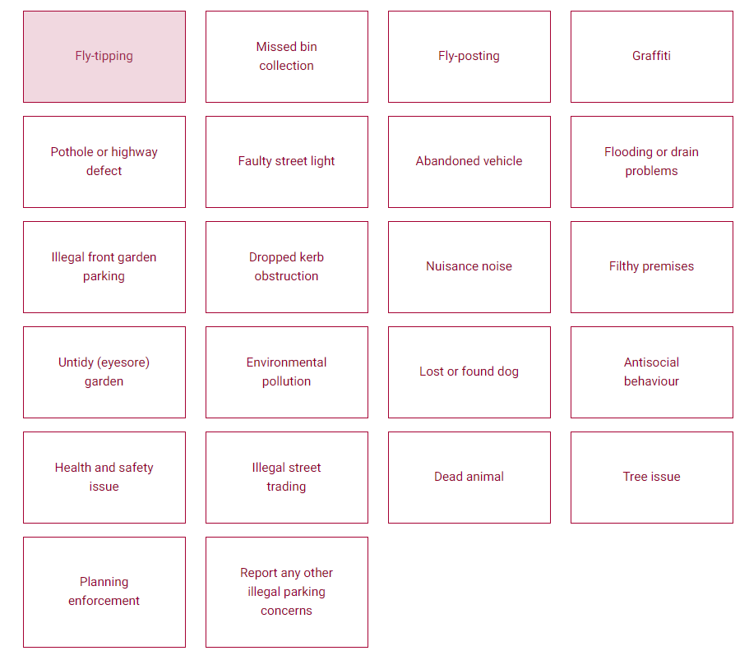
Service Requests (using Report it)
To support customers and Members we have other reporting functions other than My B&D
Report it via website https://www.lbbd.gov.uk/report-it
(each form will state, an SLA once submitted, and information is contained on each tile before you submit)
Resident Housing Repairs(non-emergency) https://www.lbbd.gov.uk/council-house-repairs
The platforms enables both customers and members to report issues directly
*Please see Appendix 1 for more detail

Slide 6
Overdue Casework
Following the 10 day period further chases are undertaken on a regular basis by the Feedback Team to ensure that cases remain a priority to close.
Weekly Reports on a Monday are sent to all Directors so that they are aware of any case which goes over the due date. It is the expectation that Directors will monitor the open cases list to ensure teams are closing cases.
Monday AM a report is produced for both the Chief Executive and Deputy Chief Executive which is also sent to all Heads of Service who have teams who appear.

Slide 7
Appendix 1 Reported via e-forms
WASTE & ENFORCEMENT
Report dumped rubbish (fly-tipping)
Report noise
Smoke and smells nuisance
Report eyesore (untidy) garden
Report illegal front garden parking
Report filthy and verminous property
Report suspected food poisoning
Report abandoned vehicles
Report fly-posting (unauthorised stickers and posters)
Complain about trading standards
Missed domestic and recycling bin collection
Missed garden waste collection
Request a new or replacement bin
Report illegal street trading and car sales
Report a lost or found dog
Report graffiti
COMSOL
Antisocial behaviour - ASB
Community trigger -follow up form after ASB
HOUSING BENEFIT
Explanations, reviews and appeals
Pupil premium registration (free school meals)
Discretionary housing payments for moving costs
General enquiries
DHP for Universal Credit
COUNCIL TAX
Propose an arrangement
ENVIROMENTAL HEALTH
Report environmental pollution
Complain about food quality or a food premises
HOUSING RENT
Request for bar-coded letter
Housing Cost Element
Request permission to discuss a rent account
Rent enquiry
TREES / PARK
Report trees
Report storms
HOUSING REPAIRS
Ability to book non-urgent housing repairs

