Slide 1

Investment and Acquisition Strategy
Member's Briefing: Investment Strategy
23 March 2023

Slide 2
Agenda:
Introduction
Investment and Acquisition Strategy (IAS) Background
IAS Governance and Controls
Investment Objectives
IAS Structure
Borrowing Strategy
IAS Income
IAS Tenures and Schemes
Key Risks and Strengths of the IAS
Protection From Downturn in Market
Questions
Please do ask any question throughout the presentation too.

Slide 3
Investment and Acquisition Strategy (IAS) Background
Started with an income strip deal in 2011/12 for William Street Quarter and Thames View; Abbey Road 2 (a turnkey) is added soon after;
Previous developments were within the Council’s HRA;
Reside is established to hold the assets;
Progresses in November 2016 to the IAS, initially invest £250m + £100m for land purchases to support regeneration and economic development;
2017 Be First is set up to accelerate regeneration in the borough;
Target investment return of 5%, with an initial target of £5m net annual income (very ambitious);
Investment decisions, acquisitions and disposals considered by Investment Panel and Cabinet where appropriate;
IAS reviewed annually and reported quarterly.

Slide 4
IAS Governance
Investment Panel (IP) advises the Chair on the approval of the IAS implementation and the schemes/developments that have been proposed. IP will consider:
    Source of funding
    Significant risks & implications from the approval of schemes
    Impact of scheme approval on Council resources & assets
    Subject specific papers or questions raised by the Chair
    Ongoing monitoring of investments delivered under the IAS
IP must monitor the expected and actual financial returns on a regular basis to ensure these are in line with the IAS & MTFS
Focus is now moving from developments to asset management, with shadow board to be established to include Reside.

Slide 5
IAS Governance continued…
Significant delays or alterations to schemes with a financial or delivery impact will be brought back to IP
Control system is in place with Gateways and Milestones to evaluate investment proposals (see next 2 slides)
  Gateways: strategic decision to proceed with an investment
  Milestones: reporting points to validate outcomes
Scrutiny at each stage includes consideration of:
  Strategic value
  Financial value
  Deliverability

Slide 6
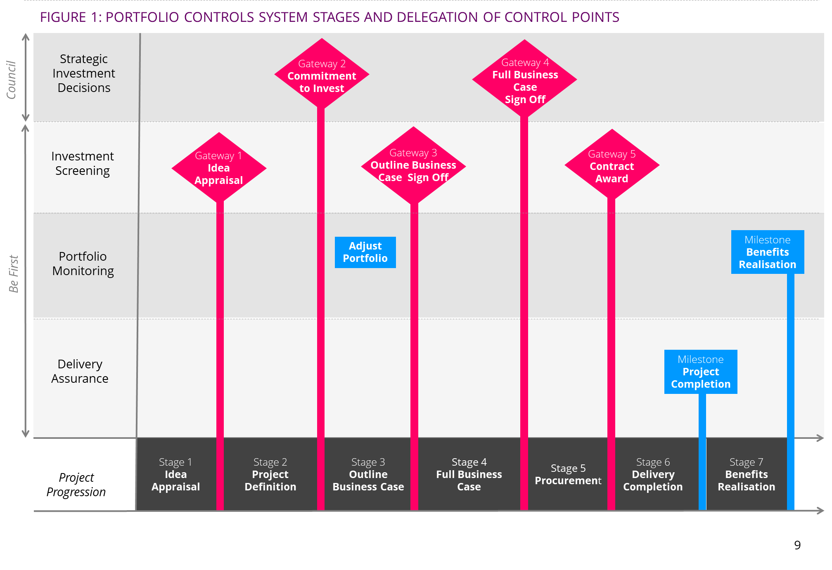
IAS Governance – Control System

Slide 7
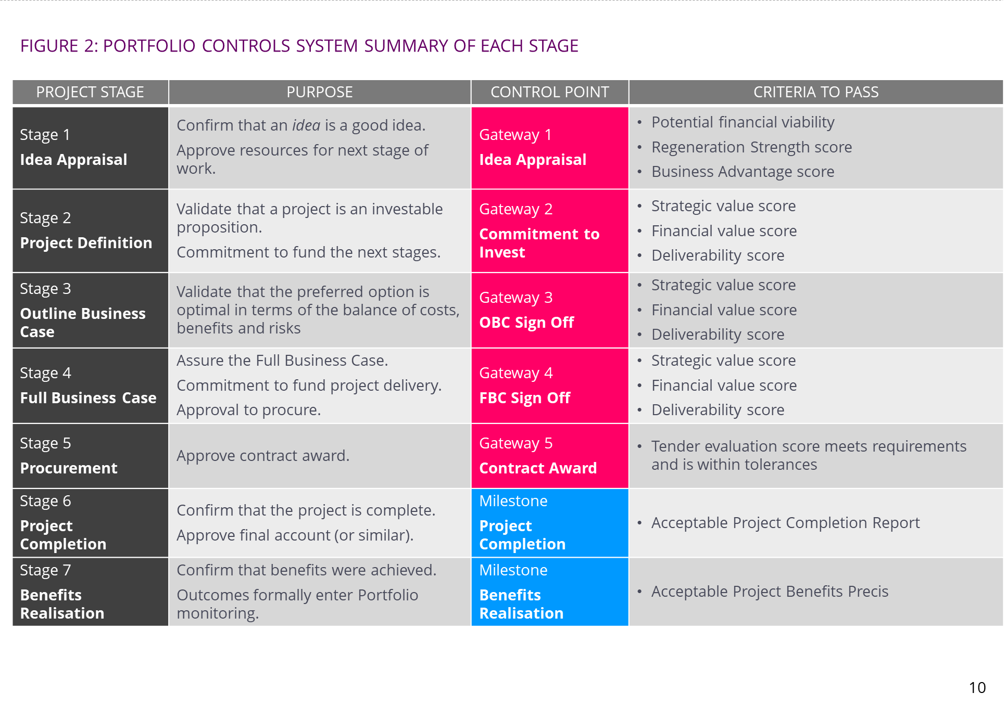
IAS Governance – Control System

Slide 8
Strategic: Unlock regeneration and economic growth opportunities in the borough and Establish a property portfolio to generate long-term revenue and capital growth.
Return: Security, Liquidity and Yield.
Risk Management: Maintain appropriate level of investment diversification across asset class, investment lifecycle; and
Development period and stabilization period risks.
Eligible Assets: Acquire & develop financial/non-financial assets to generate income & capital growth:
          residential, commercial, energy and industrial
          loan debt, with the option for equity, provided to wholly owned companies;
          ownership & financial interests in joint venture partnerships & loans to third-party entities.
Geographical: Primarily to support LBBD regeneration. If opportunities outside of borough these will be considered on a case by case (needs a clear link to Council regeneration objectives).
Select & Monitor: Schemes must meet investment criteria for the scheme.
IAS is really a LBBD Regeneration Strategy with a relatively low profit aim and high affordable rent allocation.
Investment Objectives

Slide 9
Component of the IAS
The IAS consists of a number of parts; all contribute towards the investment return target:
Residential Investments;
Commercial Investments; and
Treasury.

Slide 10
IAS Structure
Investment Decisions: Proposed by Members, officer, Be First or Reside – Cabinet make decision.
Developments: Developments managed by Be First for a fee but all spend is within the General Fund.
Commercial Purchases Purchases can be through the General Fund or through a Special Purpose Vehicle.
Completed Developments: Transferred to Reside (including a registered provider) to manage in one of their companies depending on the tenure.
Commercial, Temporary Accommodation and Realm remain within the General Fund.
Operational: Reside manage properties and use MyPlace for letting, Management and Maintenance and use the Council for debt recovery.
Income Strips A lease to the lender and lease from the operator; Council owns after the lease period.

Slide 11
Borrowing Strategy
All borrowing decisions are delegated to the S151 Officer after consultation with the Investment Fund Manager
The borrowing strategy and restrictions are reviewed each year as part of the Treasury Management Strategy Statement
The borrowing limits for 2022/23 are:
Operational Boundary: £1.6bn
Authorised Limit: £1.7bn
The borrowing funds the IAS, the general fund capital programme and HRA capital programme;
Borrowing decisions can provide the investment strategy with additional return but also can put pressure on scheme viability.

Slide 12
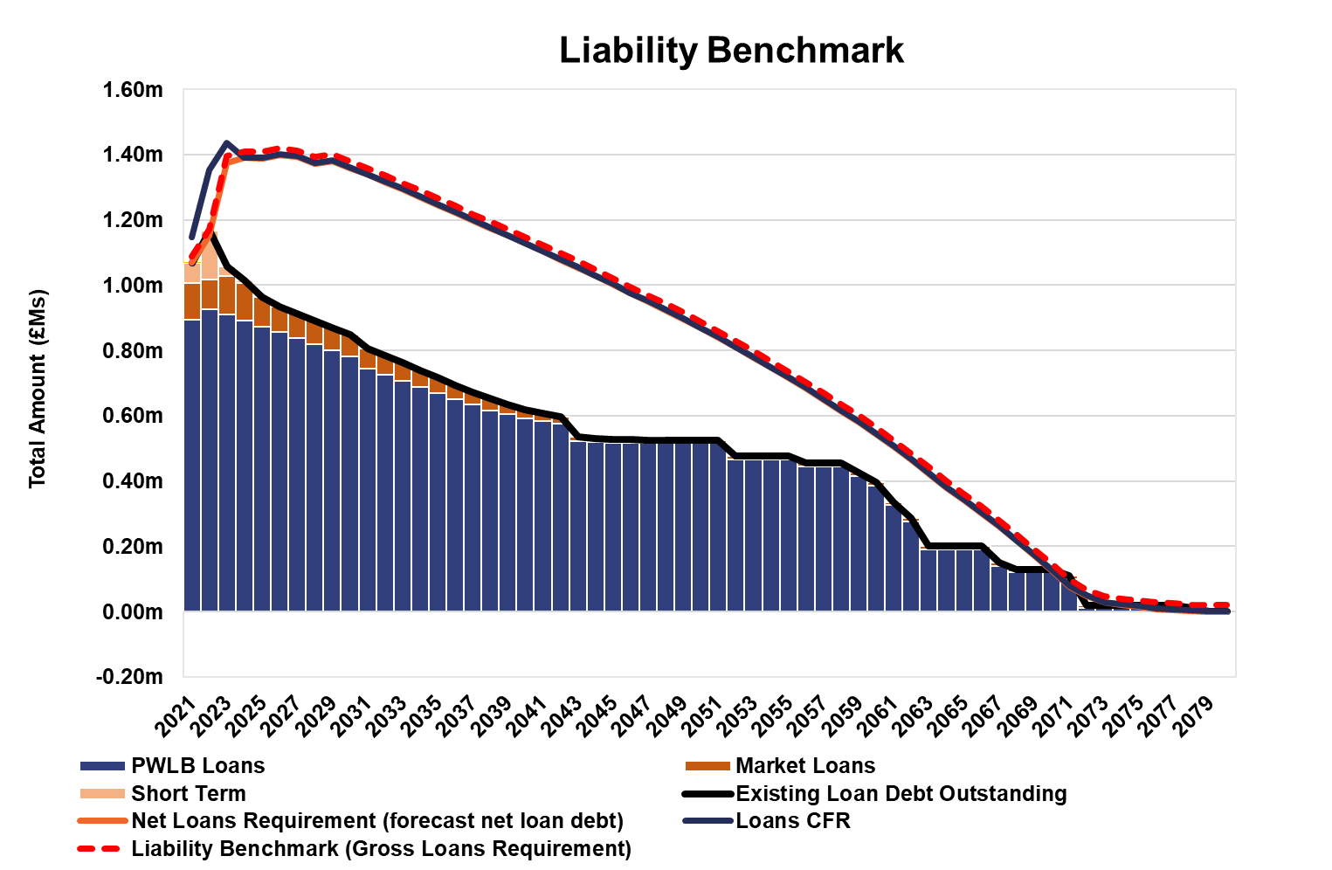
Council Borrowing Forecast 31 December 2021
As at 31/12/2021 borrowing was forecast to be £1.4bn by 2024/25;
£1.4m split into £300m HRA, £980m IAS and £120m Other.
Actual borrowing £1.08bn with cash of £225m;
In December 2021 treasury borrowed £100m at 1.35%;
Build costs increased across all schemes, fixed grant made schemes unviable;
Overall IAS was unviable;
Increased RTB receipts from 30% to 40%;
Dropped on-lending rate from 2.9% to 2.5% (rate varies);
Agreed schemes viable but only marginally and more interest rate risk.

Slide 13
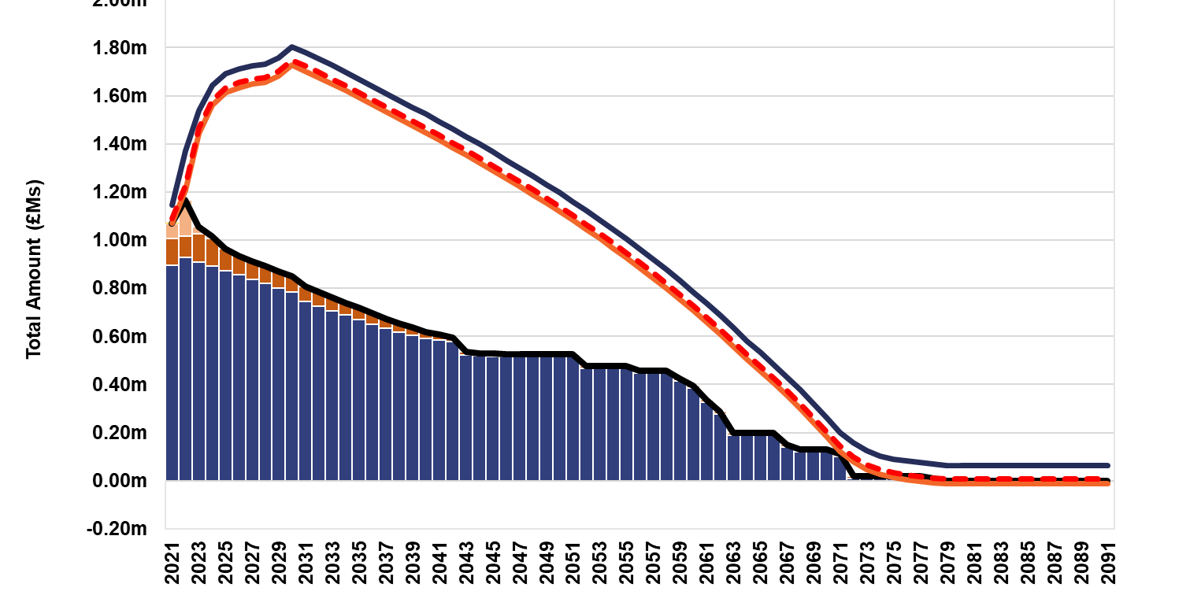
Council Borrowing Forecast 31 December 2022
In 2022 several large schemes were agreed and signed off, including Beam Park, Gascoigne East 3b and Roxwell.
The impact of these agreements, at a time when interest rates increased significantly, was to increase the borrowing requirement from a peak of £1.4bn in 2025, to £1.8bn by 2030.

Slide 14
IAS Income Forecast 2022/23 to 2026/27 as at 31 December 2021
Years | 2022/23 | 2023/24 | 2024/25 | 2025/26 | 2026/27 | Total
 | £’000s | £’000s | £’000s | £’000s | £’000s | £’000s
IAS Target | -6,922 | -6,922 | -6,922 | -6,922 | -6,922 | -34,610
Post GW4 & Turnkey | -1,423 | -4,134 | -1,707 | -1,327 | -697 | -9,288
Reside (Current) | 400 | 400 | 400 | 400 | 400 | 2,000
Commercial Income | 800 | 800 | 800 | 800 | 800 | 4,000
Be First Commercial | 1,329 | 1,329 | 560 | 560 | 560 | 4,336
Travelodge / CR27 | 1,115 | 1,197 | 1,197 | 1,197 | 1,197 | 5,903
Commercial Loans | 0 | 870 | 589 | 303 | 0 | 1,762
Pianoworks | 76 | 76 | 76 | 76 | 76 | 378
Expenses | -150 | 0 | 0 | 0 | 0 | -150
Total (shortfall) / Surplus | -4,775 | -6,384 | -5,007 | -4,913 | -4,586 | -25,669
Accumulative |  | -11,159 | -16,166 | -21,079 | -25,665

Slide 15
IAS Revised Income Forecast 2022/23 to 2026/27 as at 31 March 2022
Years | 2022/23 | 2023/24 | 2024/25 | 2025/26 | 2026/27 | Total
 | £’000s | £’000s | £’000s | £’000s | £’000s | £’000s
IAS Target | -6,922 | -6,922 | -6,922 | -6,922 | -6,922 | -34,610
Post GW4 & Turnkey | 2,597 | 1,910 | 4,225 | 1,239 | 2,179 | 12,150
Reside (Current) | 400 | 400 | 400 | 400 | 400 | 2,000
Commercial Income | 800 | 800 | 800 | 800 | 800 | 4,000
Be First Commercial | 1,329 | 1,329 | 560 | 560 | 560 | 4,336
Travelodge / CR27 | 1,115 | 1,197 | 1,197 | 1,197 | 1,197 | 5,903
Commercial Loans |  | 870 | 589 | 303 | 0 | 1,762
Pianoworks | 76 | 76 | 76 | 76 | 76 | 378
Expenses | -150 | 0 | 0 | 0 | 0 | -150
Total (shortfall) / Surplus | -755 | -340 | 925 | -2,347 | -1,710 | -4,231
Accumulative |  | -1,095 | -170 | -2,517 | -4,227

Slide 16




Further work to improve viability…..
16
Status
Agreed
WIP -No decision made yet
Not agreed
Portfolio - (change across all projects)
Project - (change on select projects only)
Solution | Priority | Status
Seek more grant from the GLA on those projects under contract | 1
Seek more grant from the GLA on those projects pre-GW4 not yet under contract | 1
Add service charge on top of the LAR rent | -
Reduce management costs on Market Rent | 3
Reduce Major Repair costs by 15% | 3
Value Engineering & Spec review to reduce build costs | 4
Utilise more Section 106/CIL subsidy if available to help fund the wider infrastructure costs | 1
Solution | Priority | Status
Reduce LAR homes on projects where there is a requirement GLA referable schemes (Gascoigne Estate, Roxwell, Oxlow) | -
Reduce LAR homes on those projects where there isn’t any reprovision (Woodward, 12 Thames Rd, Padnall Lake, Beam Park, Transport House) | 2
Viability solutions prioritised and phased reflecting that some are preferable over others and that some will take longer than others.
Seek more GLA grant/subsidy – leverage more funding to the portfolio is #1 priority
Tenure switching second phase – if the above can’t be secured then switch tenures on the easier projects first.
Operating costs review third phase – benchmarking exercise to establish target costs
VE & Spec Review of LBBD ER’s – review of where savings can be made on pipeline schemes.

Slide 17
Completed Residential Unit Delivery

Slide 18
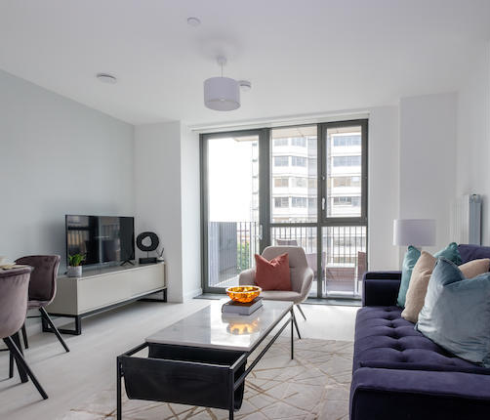
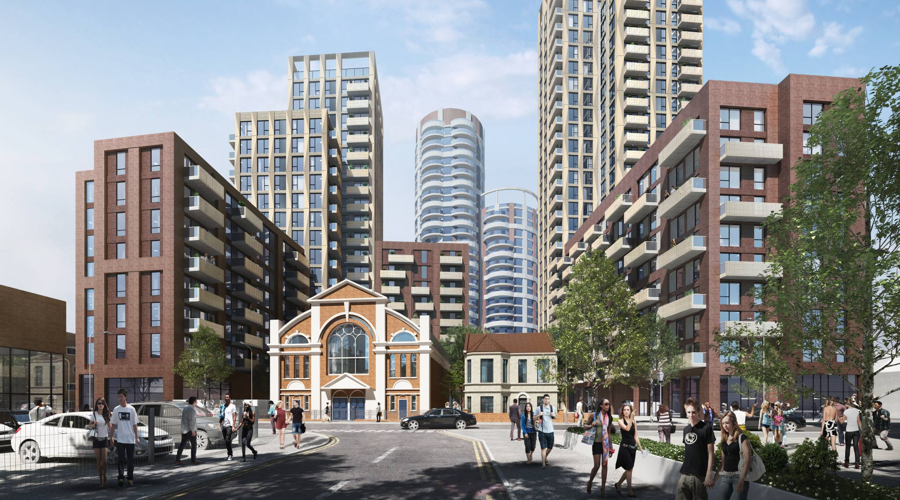
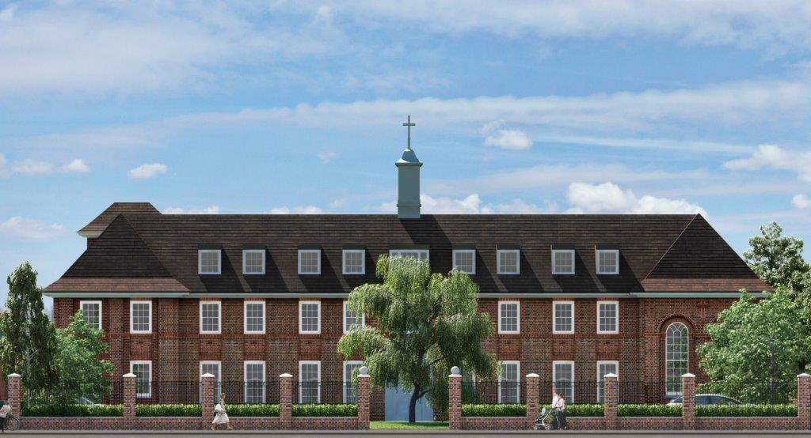
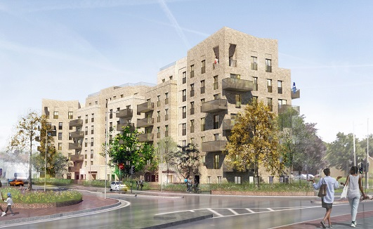
Notes:
From Left, clockwise Crown House (Challingsworth), Barking, St Margarets and Sebastian Court.

Slide 19
Projected Residential Unit Delivery

Slide 20
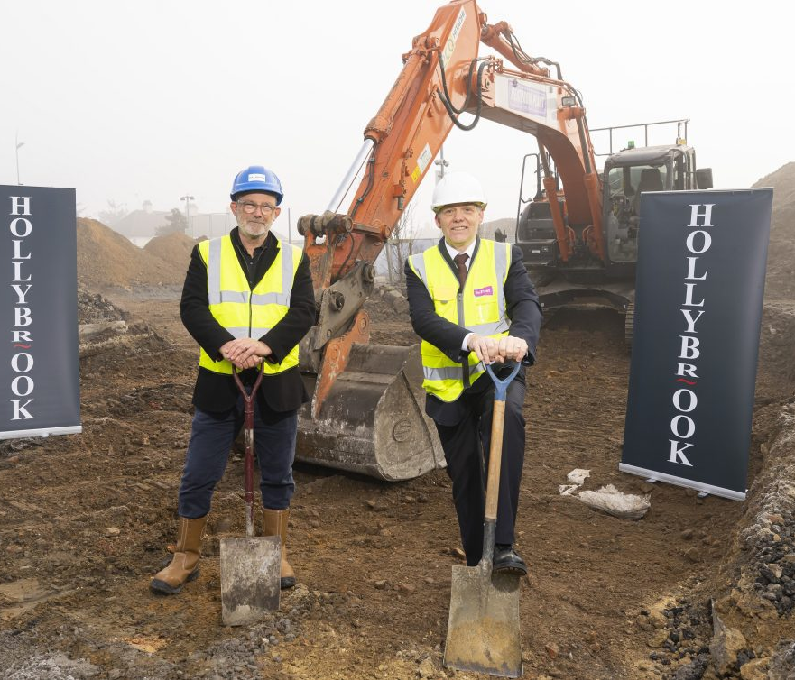
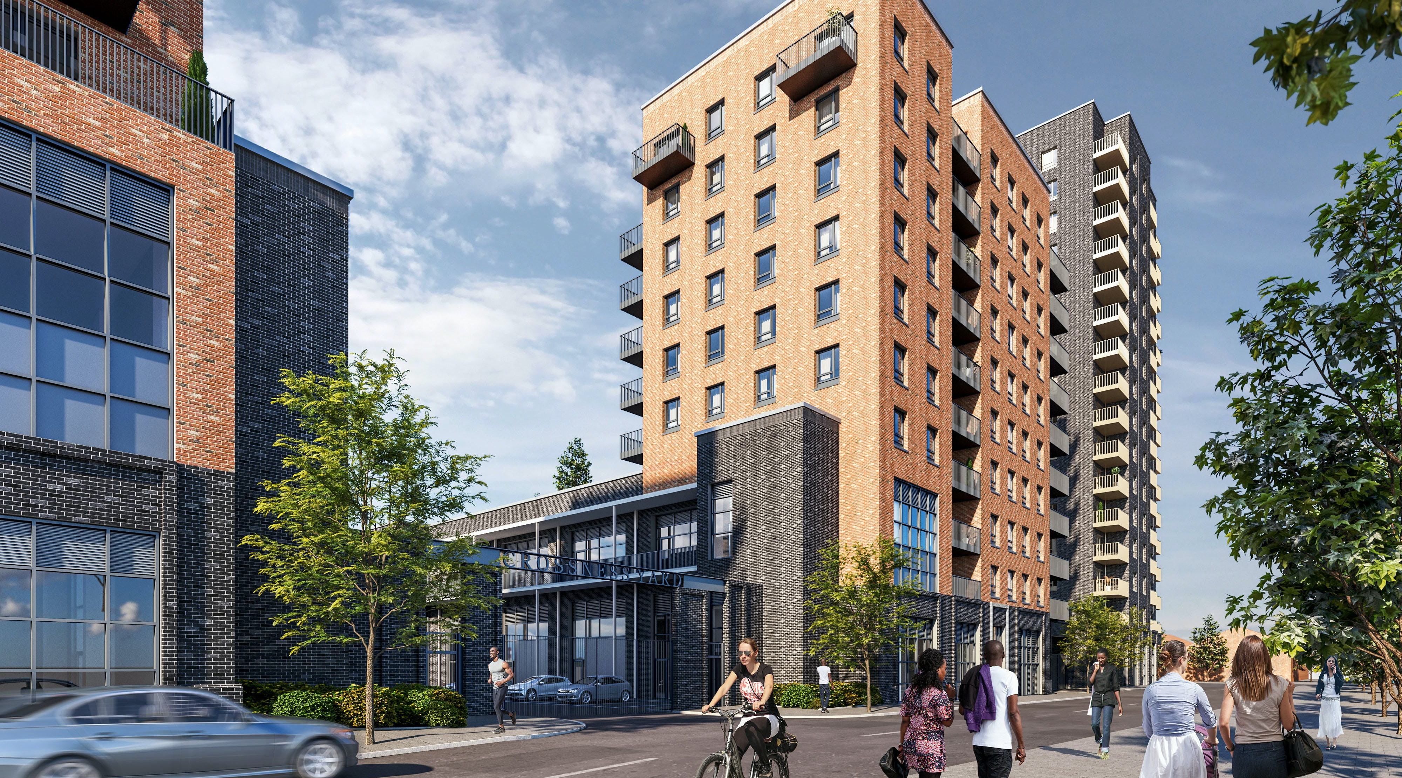
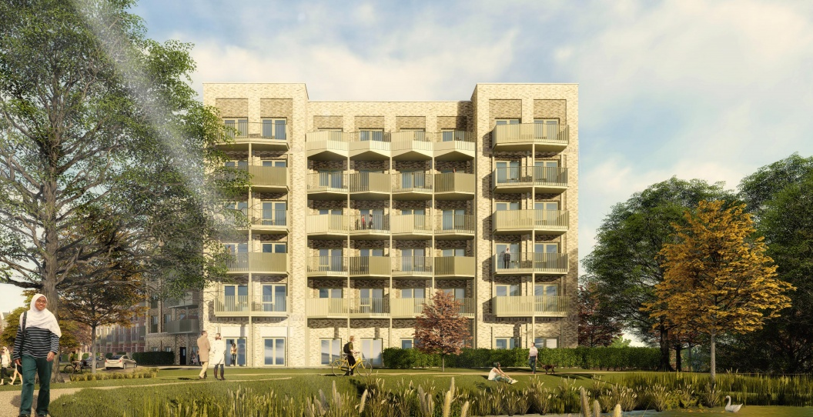
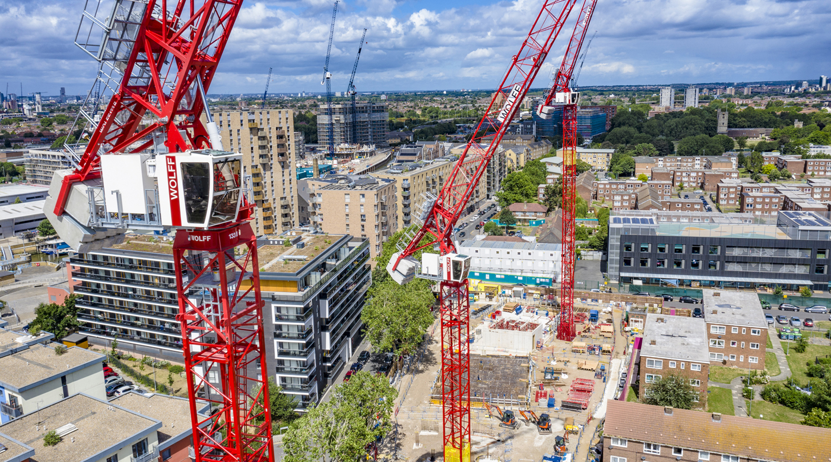
Notes:
Transport House, 12 Thames Road, Padnall Lake and Gascoigne

Slide 21
Current and Forecast Tenure Mix
Notes:
Further details of this chart is in the completed and projected schemes slide.

Slide 22
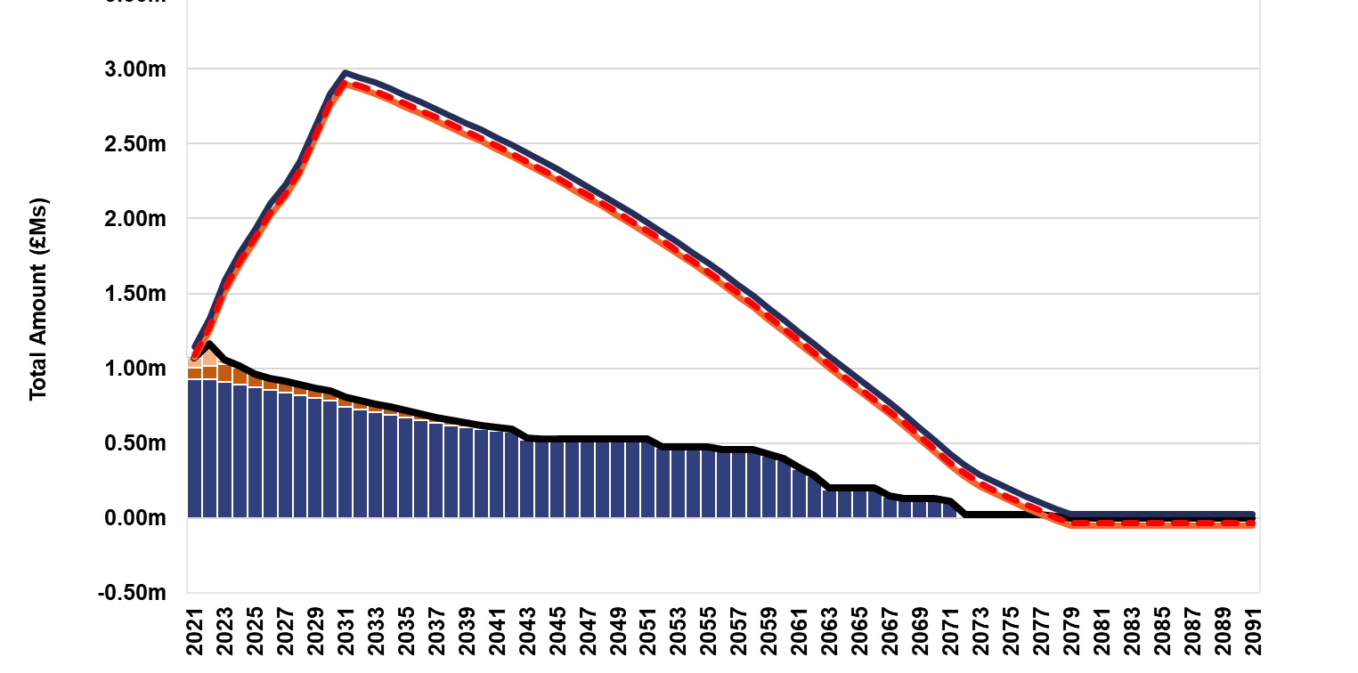
Council Borrowing Forecast 31 December 2030??
Includes estimates for:
Barking Riverside,
Dagenham Heathway/ Millard Terrace,
Gascoigne East Phase 4,
Heath Park,
Hepworth Gardens,
Ibbscott,
Padnall & Reynolds
Rest of Gascoigne West.
Excludes
Barking Town Centre
Thames Road
Other potential schemes

Slide 23
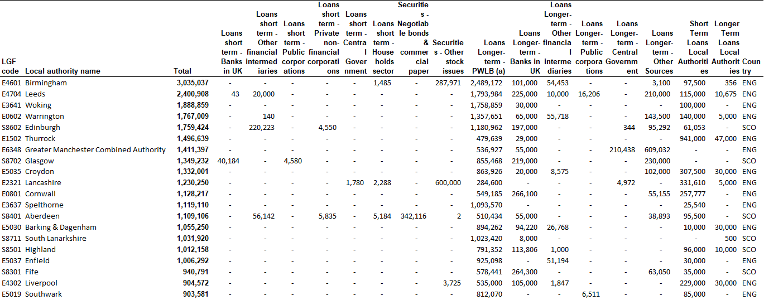
Council Long Term Borrowing to 31/3/2022
Notes:
This table shows the top 20 Councils by borrowing as at 31 March 2022. LBBD was 14^{th.}

Slide 24
Commercial Schemes
In addition Industria is being developed and will complete in early 2023/24……
Notes:
Strategy owns a number of commercial properties. When completed Industria will be added.

Slide 25
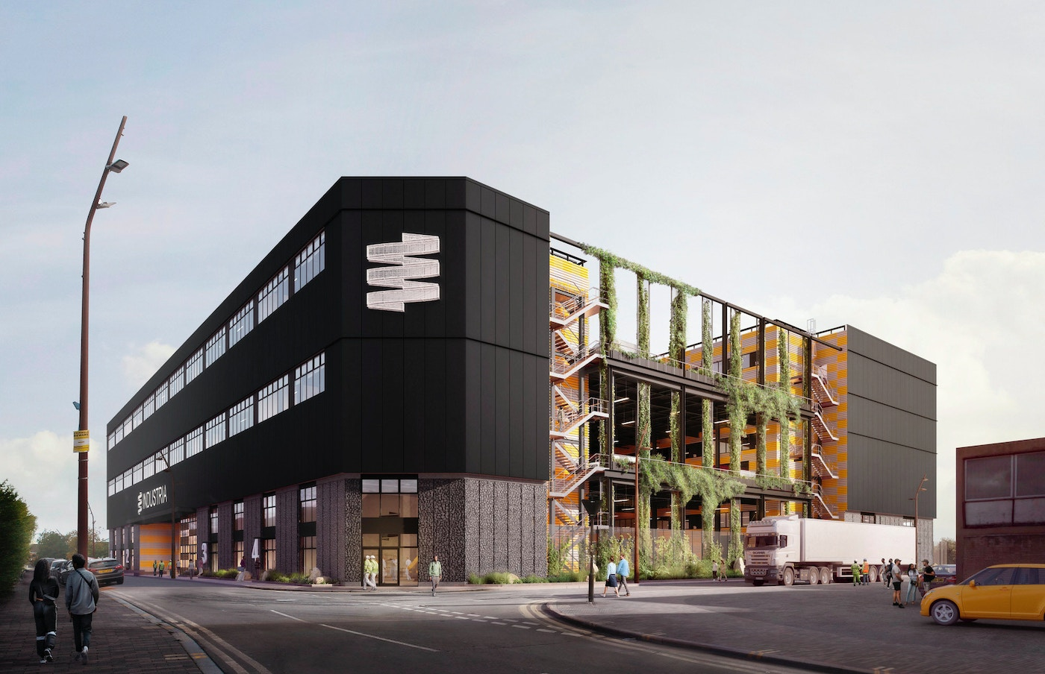
Notes:
Industria

Slide 26
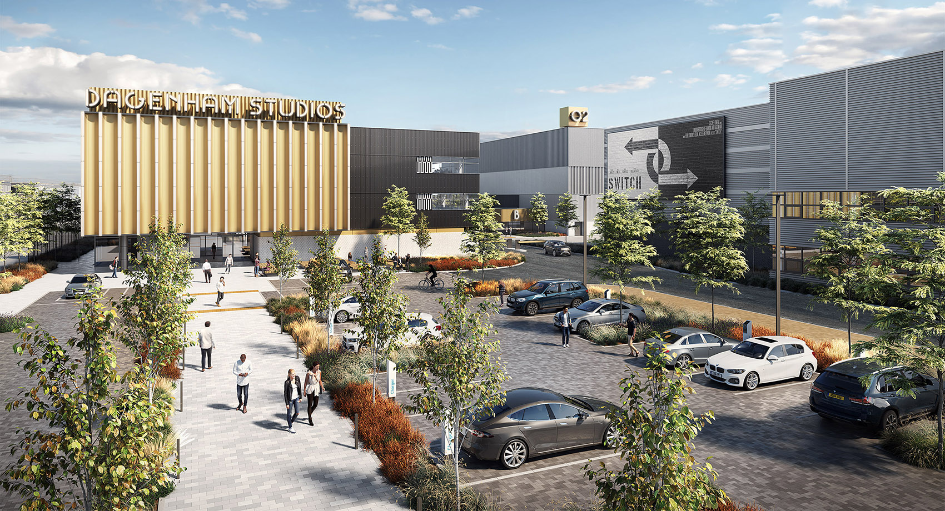
Commercial Schemes – Film Studio (Dagenham East)
Film Studio – Land Assembly
Council and GLA funded a feasibility study- resulted in report stating: “Dagenham East represents a rare chance to build a world-class film studio within the boundaries of Greater London”
Council agrees to purchase c.9 acres of land in November 2016 and c.11 acres in January 2018 and to purchase the entire LEUK site (completion January 2019) which included c.3 acres of undeveloped land to form part of the film development.
Planning application progressed; Council, through Be First, sought bids to build and run a film studio;
In August 2020 a £5.0m grant was awarded by the government to support the infrastructure costs around the Dagenham film studios;
Film studio land sold to Hackman for £53.8m and £1m Employment & Skills
Hackman have also purchased and developed Welbeck wharf

Slide 27
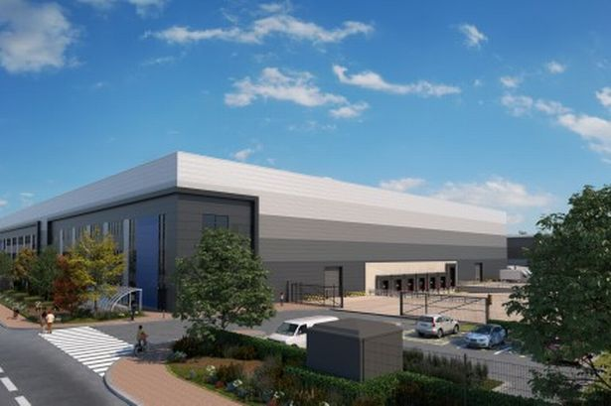
Commercial Schemes - Muller
purchased in 2020 to generate a revenue receipt for the Council from sale planned in 2023.
Property held in an Special Purpose Vehicle;
Following the purchase design work commenced to promote the site for mixed uses based on the emerging master plan and the draft local plan that seeks to transform Chadwell Heath to a new neighbourhood.
During this process the Council received unsolicited offers from both industrial and mixed-use developers.
The Council instructed Be First to formally market the site in October 2021 and a range of offers were received in the order of £74m to £100m for an industrial based scheme.
There were no offers from mixed uses developers.
Offer of £90.5m was accepted – profits to Be First.

Slide 28
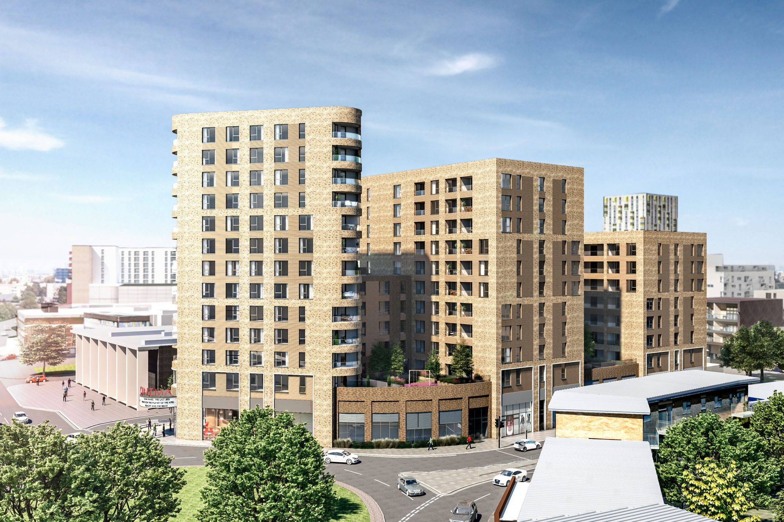
Commercial Loans
Development of Abbey Sports Centre, Axe Street
Axe Street: the Council agreed to lend Sherhill development finance of up to £28m to develop the former Abbey Sport Centre;
Sherhill opt to obtain alternative finance and pay Council £1m in cancellation fees (to Be First);
London Road, Barking Development and Loan
September Cabinet agree to lend Robyna UK LTD up to £35m for a 164 unit development;
residential-led joint development scheme with a developer (Robyna UK Ltd) on land separately owned by the Council and developer, whereby the Council would acquire the freehold ownership of the developer’s site and, upon completion of the scheme, grant the developer a head lease on the combined sites for 250 years subject to the payment of a head rent. In addition, the Council would provide the developer with a construction loan.
April 2021 and October 2022 Cabinet agreed to extend original to £52m for 196 units;
Non utilisation fee of 2.15% and loan rate of 7.10% - surplus split between Be First and Council.

Slide 29
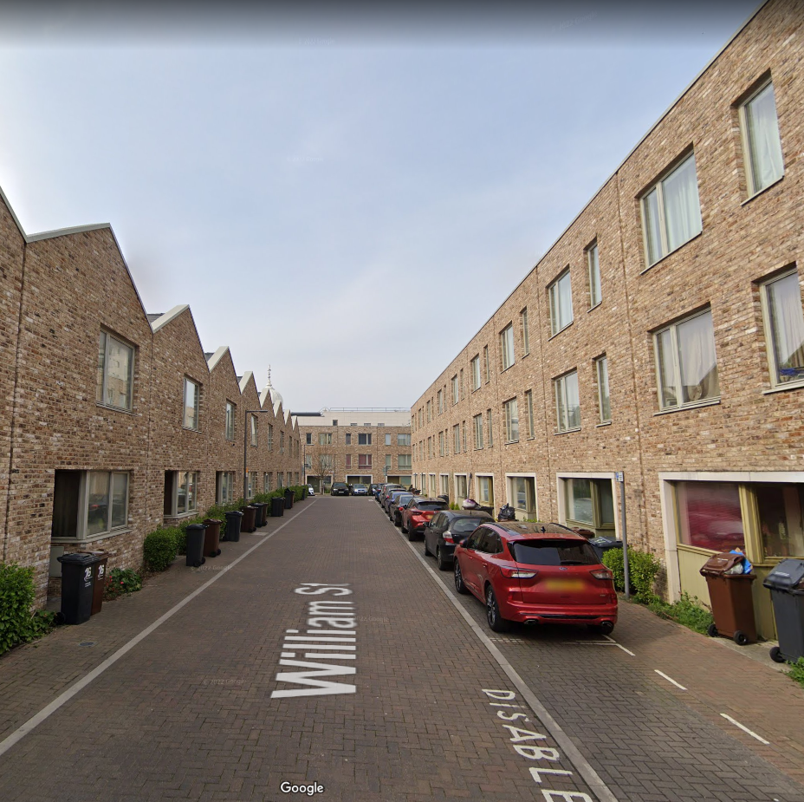
Income Strips (lease and lease back)
Reside 1
Original lease and lease back. Very challenging terms (RPI plus 0.5%)
477 affordable rented properties at William Street Quarter and Eastern End Thames View;
financed through a lease /debenture structure with an external funder (Atlantic); and
The legal / property structure is complex but can be summarised as:
Council own the freehold;
TPFL Regeneration Limited, a wholly owned subsidiary of the Council, holds a 252-year lease;
252-year leases removed at the end of the 62 year, homes revert to the Council – still 50 years to go;
Atlantic (funder) holds a 252 year lease from TPFL Regeneration Ltd, Reside holds a 62-year lease from Atlantic.
Reside Ltd pays rent (indexed by Feb. RPI) each year to Atlantic. This rent for 22/23 is £4,751,658.41. There is no cap or collar.
Company is not Regulated by the Regulator of Social Housing but the affordable rent restrictions set out in the planning permission mean Rent Standard issued by this body is best practice document.
Lease from Reside to Atlantic to increase by 13.1% - rents should increase by this amount but will actually increase by 7% and the Council will need to fund the difference.
This leaves a gap between leases to Atlantic and rents and this will be around £1m to £2m for next 50 years. Could increase further if future rents do no increase by RPI plus 0.5%.
Very risky deal and not one that should have been agreed.

Slide 30
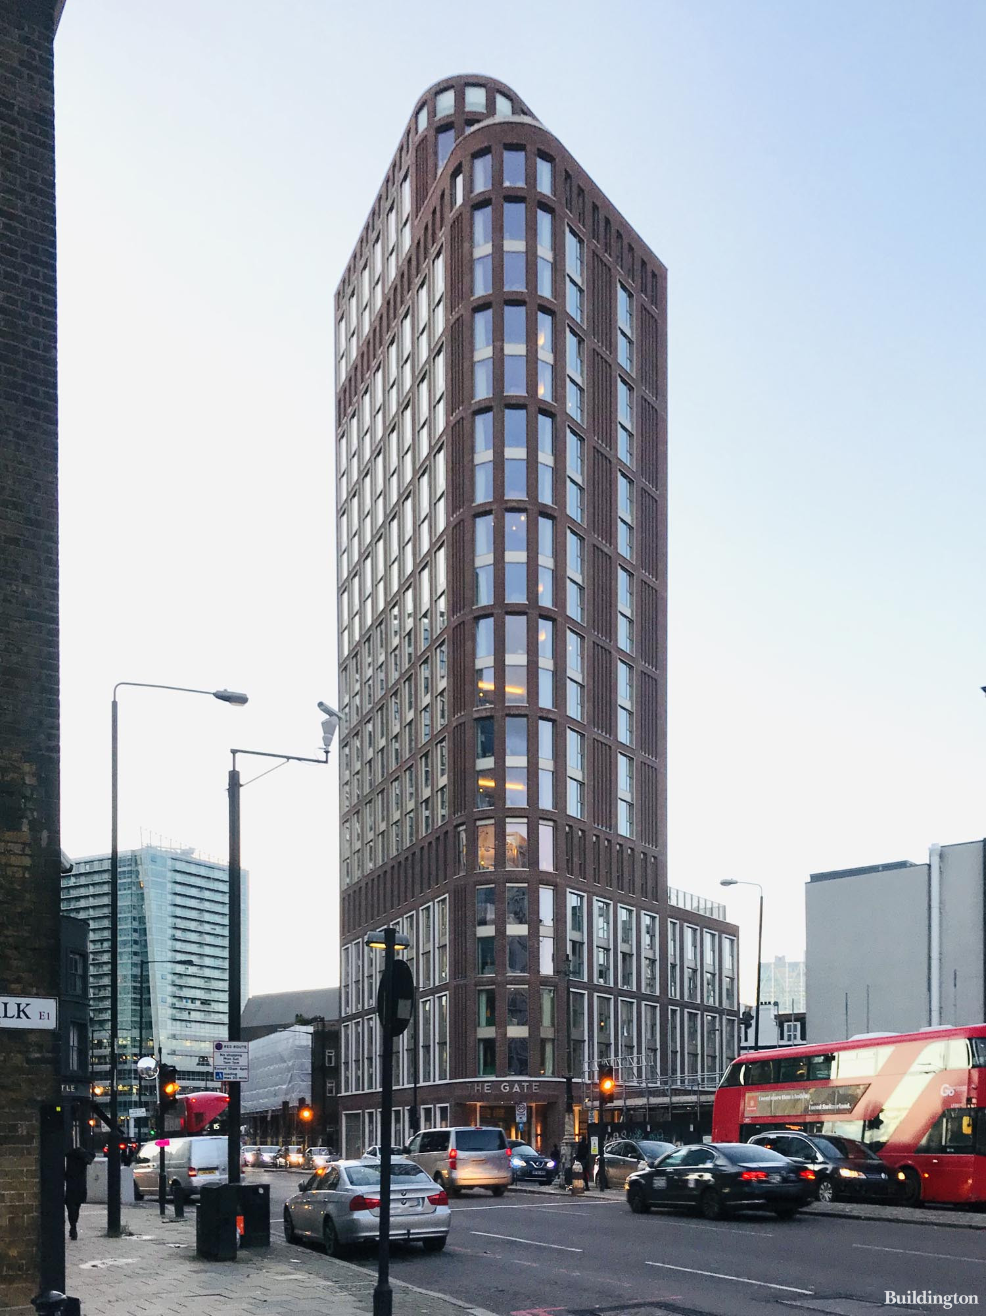
Income Strips- 27 Commercial Road (CR27, The Gate - Aldgate) – Aparthotel
Operator is Place Apart - guaranteed by Reef Estates Ltd
Headlease rent £3.598m (RPI over 50 years) with Aviva;
Council own property after 50 years, £12.3M paid to cover rent free period;
Operator rent £4.46m pa (RPI over 30 years);
Rent increase is RPI with a minimum uplift of 0% p.a. and a maximum uplift of 4.25% p.a. The terms of the rent review are mirrored within the LBBD Headlease so margin maintained throughout life of the Operator lease.
Profit retained by the Council is £862K per year and added to IAS target;
The incentive payment of £5.5m, kept in a reserve to cover any trading loss;
A corporate Social Responsibility payment of £250k;
the operator retains 3% of annual earnings from the hotel as a reserve for the upkeep of fixtures and fittings from year 3 onwards for the remainder of the lease term;
Capital Value of the new Aparthotel was £94.6m.
Risks are lease periods do not match, operator ceases and needs to be replaced, property is not maintained. Mitigated by margin and then the £5.5m in reserve.

Slide 31
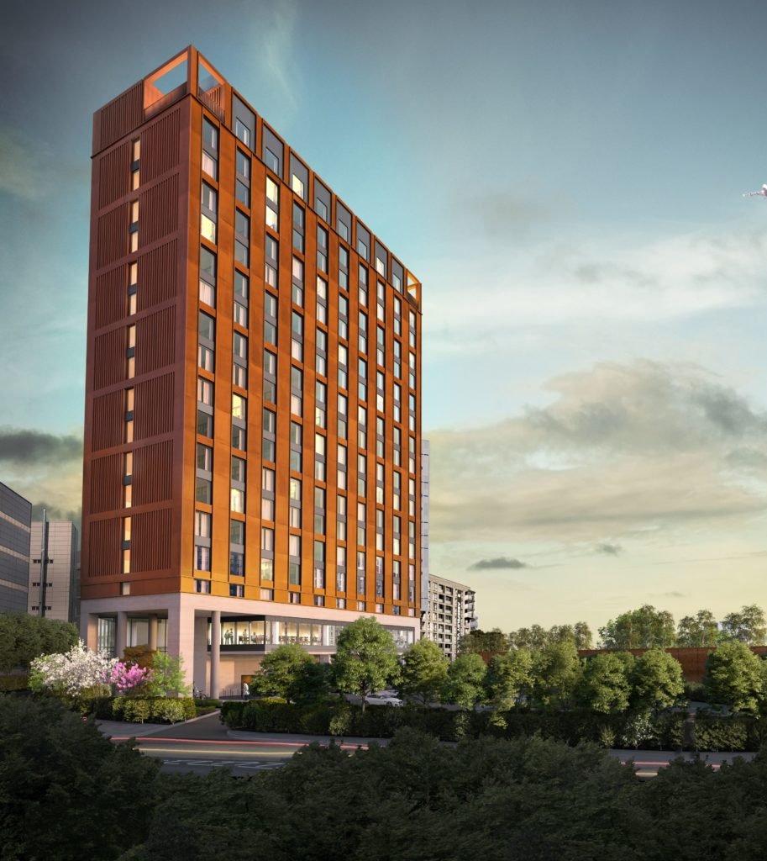
Income Strips - Isle of Dogs Travelodge
Headlease rent £3.23m (RPI over 50 years) with Aviva;
Council own property after 50 years, £12.3M paid to cover rent free period;
Operator (Travelodge) rent £2.89m pa (RPI over 35 years, can then renew);
If Travelodge did not renew their lease the Council can either seek a new hotel operator or redevelop the site for residential and/or office use.
Rents will increase every 5-years in line with RPI subject to a collar of 1% and a cap of 5%. The terms of the rent review are mirrored within the LBBD Headlease so margin maintained throughout life of the Operator lease.
Profit retained by the Council is £330K per year and added to IAS target;
The incentive payment of £15.5m, £5.5m kept in a reserve to cover any trading loss, £1.6m for stamp duty and £8.9m available for Council to use;
A corporate Social Responsibility payment of £750k;
the operator retains 3% of annual earnings from the hotel as a reserve for the upkeep of fixtures and fittings from year 3 onwards for the remainder of the lease term;
Capital Value of the Travelodge was £82m.
Risks are lease periods do not match, operator ceases / does not renew and needs to be replaced, property is not maintained. Mitigated by margin and then the £5.5m in reserve.

Slide 32
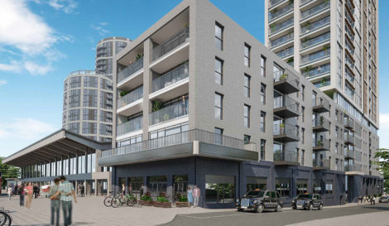
Income Strips - Trocoll
Site sits within the key regeneration area of Barking Town Centre;
198 homes, 35% affordable with Rail Pen (pension fund) and a pub;
Headlease initial rent £2.0675m (CPI over 50 years) with Rail Pen;
Council own property after 50 years;
Operator (Reside) net rent tbc but needs to be the same or more than the initial rent paid to Aviva or will make losses;
Council cannot sell the property and needs to remain in the lease for 50 years but then ownership transfer to the Council;
Rents will increase every CPI subject to a collar of 0% and a cap of 4%. The terms of the rent review will be mirrored within the LBBD Headlease to Reside.
Trocoll is currently forecast to make a loss but if initial rents are higher than the initial rent forecast then this could provide a profit but if it is lower then the loss will be larger ;
No incentive payment or corporate Social Responsibility payment;

Slide 33
Key Risks and Strengths of the IAS
Strengths
Ability to easily borrow cheaply from the PWLB, from other Councils and financial institutions;
IAS is focused within the borough, we have local knowledge, planning, strategies and know the pipeline;
Only looking for a relatively low return and can take a long-term view;
Have been managing properties for many years.
Risks / Pressures:
Macro Environment: higher interest rates, rent policies, Cost of Living;
Build costs: increased significantly over past 2 years; higher than competition, impacting viability;
Council systems and processes: IAS assumptions require Council and Reside to achieve fairly ambitious targets on letting, rents, bad debts – this needs to improve – the IAS requirements are different to the HRA. There are a lot of schemes completing and need to be able to upscale.
Reporting: needs to improve and pick up issues quickly
Loss making schemes: Reside Ltd, Gascoigne East 3b and Trocoll – all incur losses and these need to be covered by profits in other areas.

Slide 34
Protection From Downturn in Market
Pressure on the investment budget could be from a:
delay in developments becoming operational, delays investment income and interest receivable;
significant increase in borrowing requiring more interest payable than forecast;
significant drop in treasury returns either through lower returns or lower investible cash balances; and
% of assets bringing in income lower or % of assets that require development finance higher than expected.
How pressure is mitigated:
Each investment includes a profit margin based on normal market conditions. If rental is reduced, then profit will reduce but the interest and debt repayment obligations will still be met.
If conditions deteriorate to a level where profit is wiped out and there is insufficient income to cover debt and borrowing positions, then adjustments can be made to the level of return that is set aside to meet the debt repayment. This is because some of the Council’s borrowing only needs to be paid back at maturity.
In extreme cases, can reduce its investment activity & focus on more profitable assets, sell or refinance assets.

