Slide 1
Introducing localities
Members’ Briefing
28 February 2024

Slide 2
What does the briefing cover?
What are localities?
What is localities working
Community hubs
Information, advice and guidance
Early help
Why localities?
Objectives
Drivers for change
Why localities working
What is the Localities Programme?
Key areas of focus
Cross-cutting workstreams

Slide 3
What are localities?

Slide 4
What is a locality?
Is it a location?
Yes, it’s about the services that are available in people’s neighbourhood – so that they are close to our residents.
But it’s about more than that…
It’s about how services and agencies work together so residents get information, advice and help they need, when and where they need it.
A fundamental principle is enabling and empowering communities
Libraries
Community hubs
Housing officers
Social prescribers
Police
Family hubs
Community navigators
Money and debt advice
Community healthcare
GPs
Community centres
Employment and skills advisers
Voluntary and community organisations and groups
Faith organisations
Family navigators
Social care

Slide 5
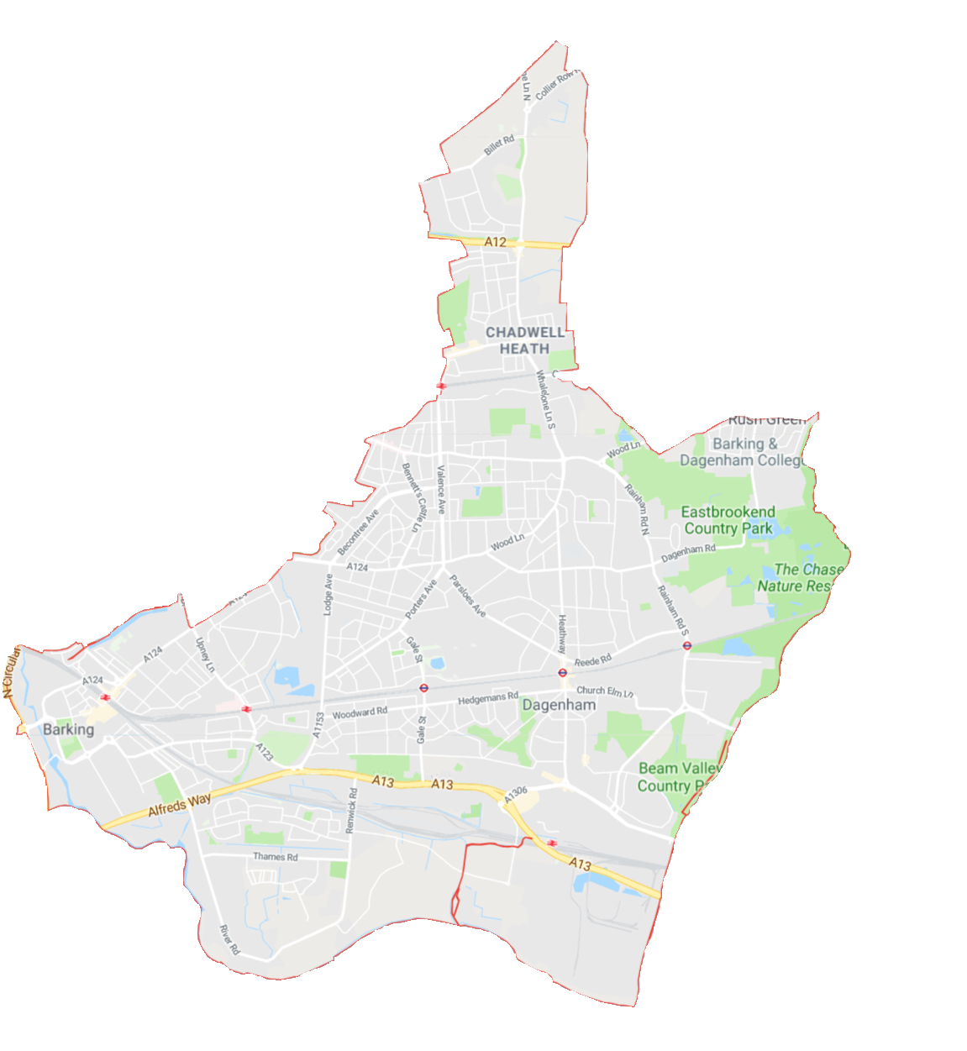
How many localities are there in B+D?
There are three localities in Barking and Dagenham.
We plan to create three teams, with each based in one locality, meaning teams and services are close to residents.
Some services will be specific to the residents in each locality, based on residents needs and wants. Some services will be available in every locality equally.
But.. We are looking with partners into a potential fourth in the south because of the new homes that are being built are increasing the population of the borough.
North Locality
NW1
East Locality
West Locality

Slide 6
What are the components of localities?
Information, advice and guidance
Family hubs
Community hubs
Community organisations
Information and advice
Signposting to services/activity
Navigators
Access points
Online
Contact centre/phone
Early help
Services and support
Activities and interventions
Integrated teams

Slide 7
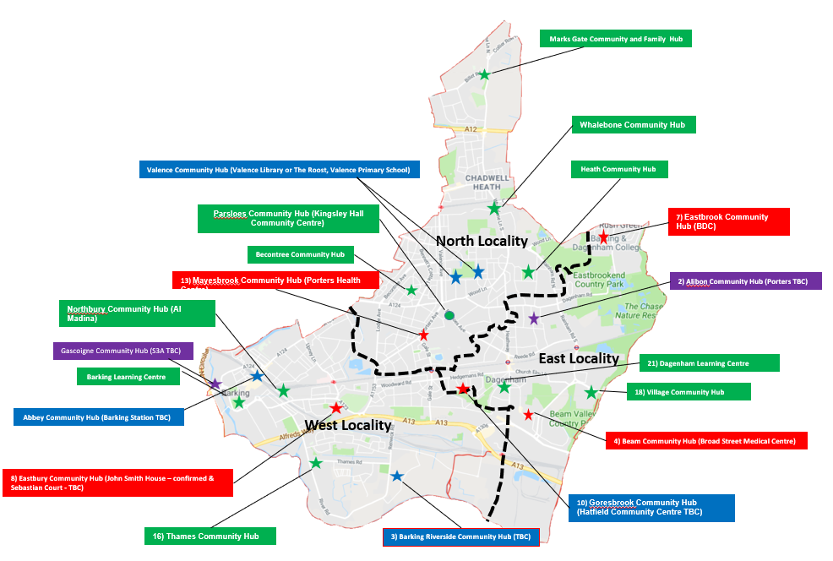
Community hub network
Community hubs are central to localities working, as place for residents to access help and as place for staff to work:
Council anchor community hubs Larger venues hosting a range of activities
Partnership community hubs Sites run by external organisations, such as VCFSE or NHS. We will work with partners to develop the offering. Those with the NHS, for example, will have greater access to healthcare and wellbeing services.
Pop-up community hubs Areas of the borough without a permanent presence will have rotating activities from a dedicated outreach/pop-up team
Pop-up clinics Regular pop-up clinics (GP, VCS, health and council services) to complement hub activity

Slide 8
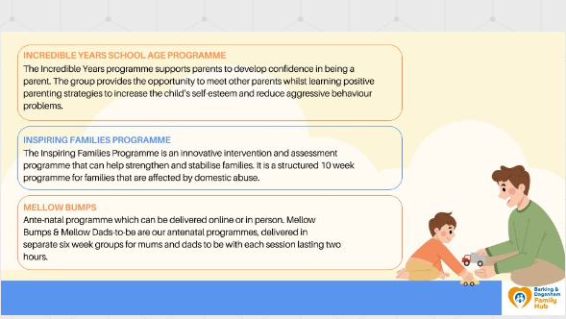
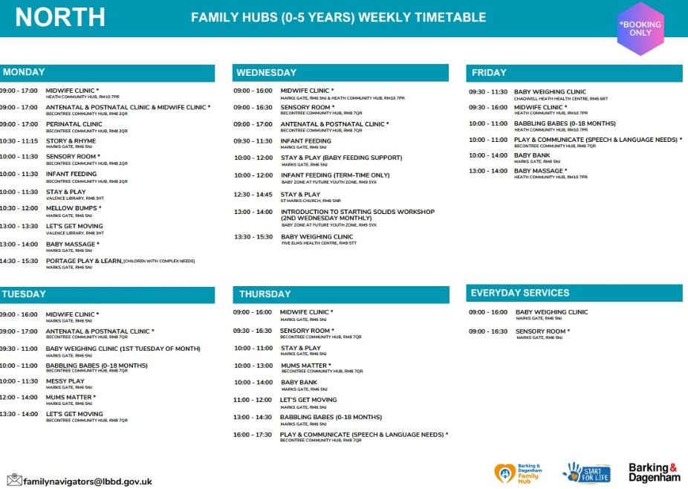
Family hubs
What are families saying?
93% said that they got what support they need and 7% said that they got some of the support they needed
Families would like support with:
Parenting of their child
Education/school
Financial advice or signposting
Housing
Families also expressed that they would like support with: access to disability services; food and clothing; getting my son ADHD assessment; and assisting with bedding and speech and language.
Three community hubs are designated as family hubs: Barking Learning Centre, Dagenham Library and Mark’s Gate
One open, second spring, third summer
Funded by pathfinder money from Department for Education
Provides activities and support:
Infant, parenting and family activities
Learning and online support
Help to stay healthy and safe
Expert help around disability
For families that need additional help, family navigators support families to access the right help including the Early Help Service

Slide 9
How can residents access information, advice and help?
Online ‘one-stop shop’ for self-service information, advice and signposting
Contact centre and frontline teams – key is linking to web and hubs
Network of hubs – community hubs, family hubs and specialist hubs
Online
Phone
Hubs
Information, advice and guidance on wide range of topics
Signposting to other services, and help from a ‘navigator’
Anchor and place to meet for networks and community groups
Book an appointment with targeted help, such as the HAM hub
Range of activities, from early years to volunteering
Allied closely to pop-up clinics, offering outreach across LBBD

Slide 10
What information, advice and guidance is on offer?
Residents can access advice on a wide range of topics:
‘Universal’ such as activities, volunteering or council services
‘Targeted’ such as around homelessness, money, employment
Advice and signposting to partners
Not all these activities and advice will be provided by council staff. Key to localities working is the involvement of partners such as health, police and voluntary, community, faith and social enterprise (VCFSE) groups
Housing and homelessness
Money and debt
Health and wellbeing
Employment and skills
Volunteering and connections
Council services
Police
Community healthcare
Healthy activities
Arts activities
Family activities

Slide 11
Who will be in each locality team – from the council?
Each locality team will include:
Family + community hub staff
Family navigators
Community navigators
Social prescribers
Outreach officers
Library staff
Specialist hubs will also operate across the whole borough from locality sites:
Homes and money hub
Employment and skills hub
Health and wellbeing hub
Social justice hub
Every locality team will focus on:
Providing excellent information, advice and guidance
Running activities such as play groups and peer-to-peer support groups
Identifying and reaching out to residents who might be struggling
Providing opportunities for volunteering and connecting with others
Signposting to support services aimed at keeping residents well and independent
Working with communities and voluntary, community, faith and enterprise sector groups to develop activities and support that residents need and want
Notes:
Could be hostage to fortune if miss someone out…

Slide 12
Early help and statutory services
Someone to help guide residents to the right advice and help
Social prescribers
Family navigator
Community navigator
When residents are struggling or at risk of tipping into a crisis, they can access more targeted support including Early Help services
Early help services
Community healthcare
GPs
Social care
Parenting experts
The ‘front door’ to statutory social care, which we intend to develop as an integrated door with NHS and other partners. It also covers safeguarding referrals
Adult intake team
NHS front door
VCFSE front doors

Slide 13
What is early help for adults?
The offer will be developed in alignment with that of family hubs and early help for children’s and families
Community navigators*
Help to find the right advice and support
Healthy lifestyles
Classes, advice and help to achieve a healthier lifestyle
Reablement
Short-term help after an illness or crisis to get back on your feet
Independence
Help to live independently for vulnerable groups
Early help support*
Help to get back on track if a resident is struggling to cope
Preventing falls
Advice and aids to help residents prevent a fall
Assistive tech*
Tech to help residents live independently at home for longer
Cost of living
Advice, help and signposting to ease financial pressures
Mental health support
Connections, advice and signposting
Peer support*
Groups and networks of residents who are facing similar issues
Social prescribing
Expert help to support residents to connect with community help
Homes and money
Expertise in managing finances and housing issues
* Denotes services in development

Slide 14
Why localities?

Slide 15
What are the vision and objectives?
Draft vision:
The right information, advice, guidance and support at the right time, in the right place, by the right people, that improves life chances, independence and resilience and ensures no one is left behind.
Doing this will enable us to:
Identify and engage those who are struggling
Reduce ‘crisis’ demand
Increase independence (especially for learning disability, autism, mental health) – across health, housing, employment etc…
The localities programme is underpinned by Our B+D, Our Future, and its five priorities: Young; Fair and Aspiring; Live Well in; Our Place in; and Clean and Green
Within this, the ambition is to reorientate universal services to become more targeted and work more preventatively and proactively in neighbourhoods, bringing services closer to residents

Slide 16
Why develop localities?
Need to right size the organisation, ensuring better outcomes for residents
Too much support is provided only when residents fall into crisis – be that illness or losing a house or job. We need to act earlier to help people stay well and independent
Too many activities and interventions not having the impact we expected or intended. Lack of evidence that activity impacts positively on demand. Conversely, the early help service has reduced by 28% in real terms the number of children in need on plans since 2021/22
Activity and services not consistently targeted on those who are more vulnerable – many are ‘universal’
Low awareness of services and activity – over half of respondents to our Cost of Living Survey don’t know there is anywhere to get advice on debt, housing etc within 15 minutes of their home
Central to localities is collaboration. The issues facing our populations are complex and deep-seated, and we can solve them only by working with statutory partners as well as communities and their groups
Working at ‘place’ with partners, brings greater collaboration, coordination and less duplication
Changing population – growing, younger, more diverse – so we need to adapt and evolve services

Slide 17
What will be the benefits?
Better outcomes for residents
Right information and advice first time every time – therefore helping residents stay independent and well for longer
Advice that prevents, reduces or delays need – thus reducing demand for statutory provision
Help to residents is more targeted, helping those who are struggling
Services and help are closer to residents
Being more proactive in reaching out to residents
Stronger and deeper partnership with voluntary, community and faith organisations and groups
Greater focus on reducing health and wellbeing inequalities
Right sizing the organisation
Access to support is more integrated and streamlined
Leaner management structure, to maximise expenditure on residents and services
Simpler structure for services and teams, with clearer leadership oversight
It’s easier for teams to collaborate more, centred on the needs of residents
Universal services focused more on challenges residents face
Increased use of data to guide support

Slide 18
What is different about localities working?
Hub
Hub
Hub
Greater focus on outcomes – and working collaboratively around residents and communities
Stronger partnerships – not only statutory partners such as NHS or police but also voluntary, community, faith and social enterprise groups, and residents themselves
Creating joined-up teams across council departments and external partners
Teams collaborating and working out of community hubs and other venues to be closer to residents
Making it easier and quicker for residents to get the right advice and help when and where they need it
Developing activities and help that mean we support residents to keep well and independent
Being proactive in using our data and expert knowledge of our residents to identify and engage those who are struggling

Slide 19
What’s the evidence?
In Leeds, the social value for the city’s 12 ‘asset based community development’ pilots was within the range of £5.07 and £14.02 for every £1 invested. The model consists of community builders (workers hosted by neighbourhood organisations), community connectors (individuals living locally who may organise and support local activities) and ‘small sparks’ grants.
An evaluation of Derby’s local area coordination programme found it is delivering significant social value with up to £4 of value for every £1 invested
Our Mental Health and Debt pilot supported 77 people to manage debt better, resulting in a fall of council tax and rent arrears of £22,000 as well as maximising resident income (eg benefits).
In 2014, the Wigan Council launched The Deal as “an informal agreement between the council and everyone who lives or works in Wigan to work together to create a better borough” centred on a “new social relationship” between the council and local community. By February 2019, The Deal had saved the council £141.5m through efficiency measures, reforming services and reducing demand. Wigan's female healthy life expectancy increased by 20 months from 2009 until 2011 compared to England's decreasing by two months. Men’s increased by 26 months compared to England's increasing by four.

Slide 20
What is the Localities Programme?

Slide 21
Vision and objectives
The right information, advice, guidance and support at the right time, in the right place, by the right people, that improves life chances, independence and resilience and ensures no one is left behind.
To get there:
Focusing on preventing, reducing and delaying need
Being more proactive and purposeful in how we work with each other
Organising information, advice, guidance and support on a locality model
Increasing collaboration across the council and with residents, communities, partners and the community and voluntary sector
Developing and encouraging more holistic and tailored solutions
Year 1 (24/25): developing the infrastructure and key elements (hubs, locality teams, IAG offer etc)
Year 2 (25/26): embedding the approach across the borough

Slide 22
Key areas of focus
The three areas of focus are to:
Identify and engage those who are struggling
Reduce ‘crisis’ demand
Increase independence (especially learning disability, autism, mental health)
These areas are supported by cross-cutting themes:
Community and family hubs network
Locality teams and working
Front door improvement and integration
Prevention offer development
Community-led approaches
Building data and insights
Digital and technology

Slide 23
Community and family hubs network development
Network
Opening all hubs, as council, partnership or pop-ups – developing as a network
Strengthening links between hubs – community, family and specialist
Developing further specialist hubs, eg health and wellbeing, dementia, social justice/cost of living
Activities
Developing community hubs activities offer – wide range of activities and drop-in sessions/clinics
Bookable appointments systems
Outreach
Outreach teams will develop a schedule of pop-up community hubs in less accessible locations
For more vulnerable groups, we will pilot an assertive proactive outreach approach, targeting residents to engage them for early assistance, and also to drive engagement and footfall at hubs
Comms and engagement
Extensive comms and engagement will seek to increase awareness of community hubs offering

Slide 24
Locality teams and working
Piloting approaches to integrated health and care teams:
‘Porter’s Avenue’ Health Campus
Pop-up clinics
Proactive Care
Front door improvement and integration
Developing preventative, community-led support available to support people before they reach crisis or need statutory support
Working in partnership to develop an integrated front door with statutory and voluntary partners

Slide 25
Prevention offer / Early Help
Developing activities and interventions
Low-level mobility support
Falls preventions
Employment and skills for people with learning disabilities and autism
Reablement support to recover from illness
Healthy eating and activities in the community

Slide 26
Community-led approaches
Building on strong existing collaboration and partnerships
Community locality leads work around health inequalities – developing networks of local groups and resident-led groups
Cost of living support
Developing community-led activity and support around key areas including healthy lifestyles, and independence for vulnerable groups (learning disability, autism, mental health)
Partner-led community hubs, and networks of groups working out of hubs

Slide 27
Data and insights
Business case development – defining, problem statements, benchmarking
Engagement – widespread across members, residents, staff, partners
Locality profiles – building shared picture using quantitative and qualitative insights
‘Data week’ – how are residents accessing information, advice and guidance? How do they want to?
Digital and technology
Directory of services
One-stop online shop

Slide 28
Any questions?

