Slide 1
INTEGRATED CARE SYSTEM AND BOROUGH PARTNERSHIP PROPOSALS AND GOVERNANCE June 2022

Slide 2
Background
Integrated Care Systems (ICSs) are partnerships bringing together providers, commissioners, local authorities and other local partners to plan services meeting local needs.
In July 2022, ICSs will become statutory and be led by two related entities at system level: an ‘Integrated Care Board’ (ICB) and an ‘Integrated Care Partnership’ (ICP). Together referred to as the ICS. Their purpose is to integrate care across different organisations and settings, joining up services and to lead the following on behalf of their population footprint:
Improve outcomes in population health and healthcare
Tackle inequalities in outcomes, experience, and access
Enhance productivity and value for money
Help the NHS support broader social and economic development
In addition to the two governing bodies, there will be three other core components of the ICS system:
Provider Collaboratives
Place-based Partnerships
Primary Care networks
Notes:
Subsidiarity remains the key principle for the ICS, with planning decisions made as close to the local community as possible and at a larger scale where there are demonstrable benefits or where co-ordination across places adds value

Slide 4
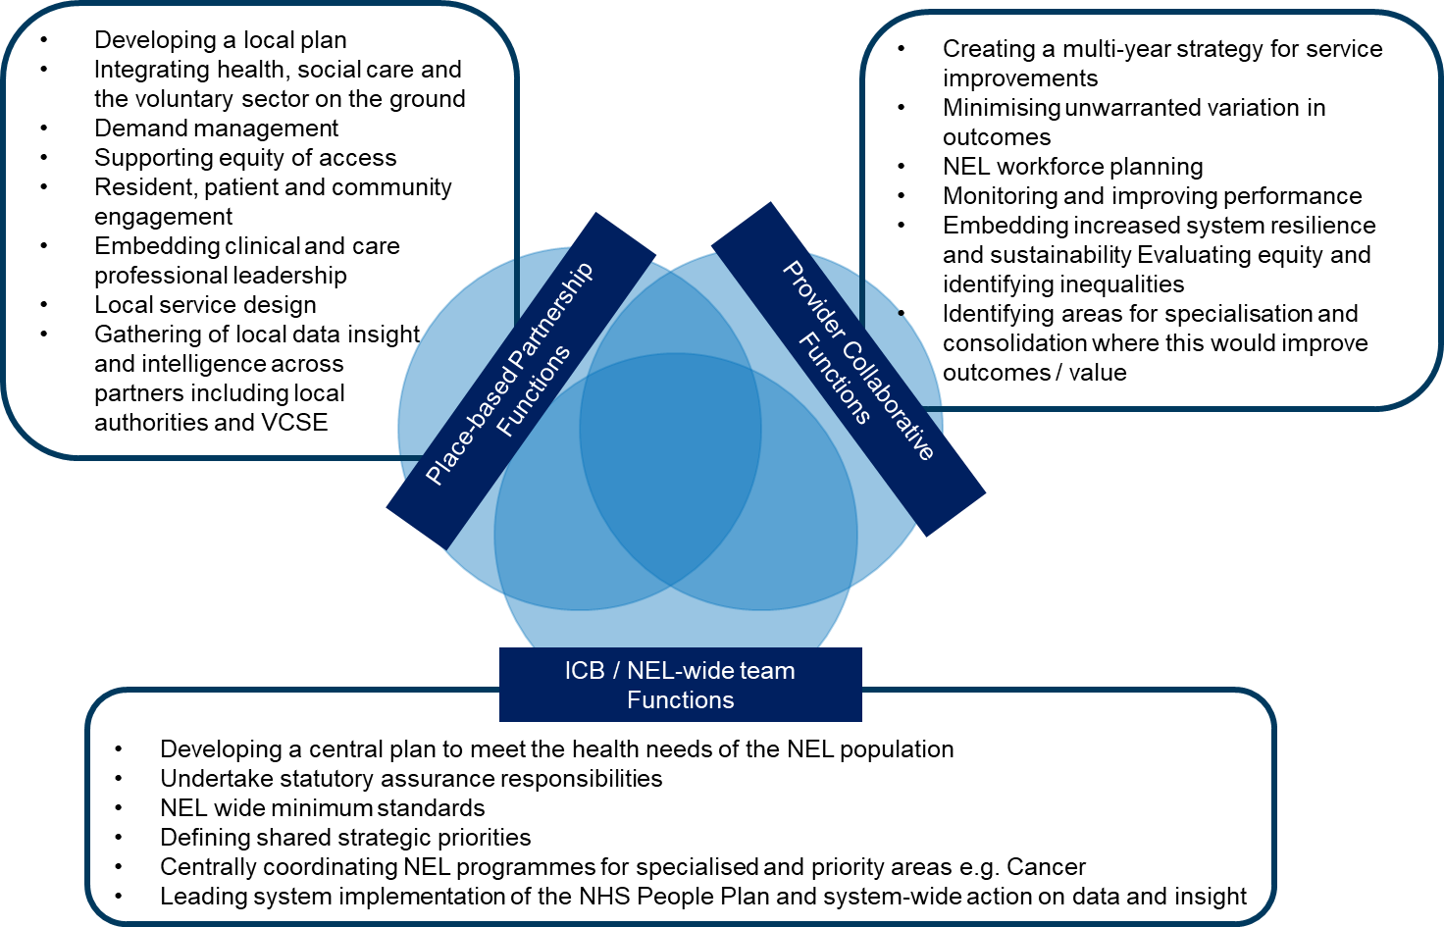
Functions Across the System

Slide 5
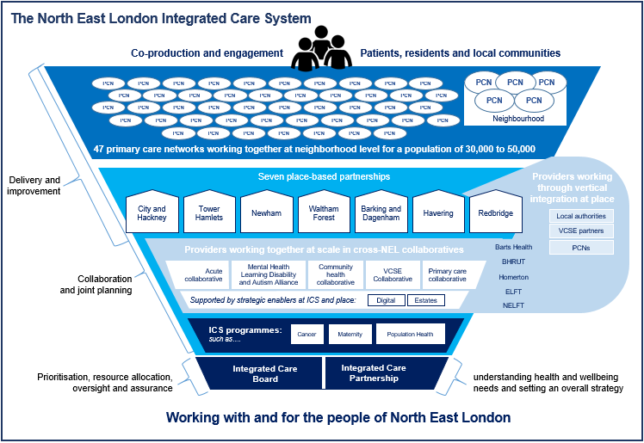

Slide 6
The B&D Ambition
The local ambition is for the Delivery Group to evolve into Partnership Board and work with the ICB subcommittee in an integrated way (joint meetings - agendas, papers etc) – similar to other NEL boroughs​.
The Board and ICB Subcommittee will be jointly chaired by an LBBD Elected Member and Clinical Director- similar to other NEL Boroughs.
B&D Partnership Board will have two delivery pathways- an adults and a separate child, young people and family’s pathway (CYP&F) operating under the Board.
These pathways could be better supported by formal arrangements, underpinned by contractual mechanisms and/or pooled budgets between partners.
Adults current priorities: health inequalities (COVID recovery); improving mental health and wellbeing; providing proactive care and reactive support through the development of an MDT model
Childrens priorities (still in development): care needs of the most vulnerable children (e.g. looked after children); anticipatory care support for Children with SEND and reducing escalation to EHCPs; low level mental health and wellbeing; childhood obesity and preventing domestic and serious youth violence
Arrangements will be formalised in April ‘23, following a period of operating in shadow form from 1st July- 31st March ‘23

Slide 7
Place Based Partnership (proposal)
Provider collaboratives – acute, primary care, community & Mental health
HWBB
LBBD Exec functions
B & D Partnership Board
ICP
ICB
ICB Sub Committee
Childrens Partnership
Delegated ICB functions
Quality
Safeguarding
TBC
Adults Partnership

Slide 8
Proposed Role Of The Shadow Partnership Board (terms of reference will be agreed at first meeting after 1st July)
To work in partnership to improve health and wellbeing and reduce inequalities
To set a local system vision and strategy
To develop the Place Based Partnership Plan for B&D (‘PBP Plan’),
To provide system wide accountability for the delivery and performance of the PBP plan
To review and assess new and revised models of care and to achieve agreed outcomes
To develop and deliver a framework of community engagement
To provide direction and oversee progress to the life course workstreams (adults, and CYP)
To provide a forum to share insight and intelligence into local quality matters, identify opportunities for improvement and identify concerns and risk to quality
To have oversight of how resources are utilised at place to inform discussions on how best to use money across the system
To support the ICS to deliver against its strategic priorities
To develop the formal Place Based Partnership governance at place for 1st April 2023

Slide 9
The Role of the ICB Place Subcommittee - a statutory body of the ICS
Exercise delegated functions at place (still to be confirmed)
Make decisions, authorised by the ICB in relation to them regarding local objectives and priorities
Support collaborative arrangements- including the development of the ‘place based plan’
Support ICB with aims and ambitions re joint plans and strategies
Prioritise delivery against strategic priorities of the ICS
Support discharge of statutory functions- supporting the core purposes of the ICS:
Improve outcomes
Tackle inequalities
Enhance productivity and value for money
Support broader social/economic development

Slide 10
Partnership Board (TBC) | ICB Place Committee (TBC)
LBBD Elective Member (Joint Chair) LBBD CEO (ex officeo) Strategic Director Children and Adults (DAS & DSCS) Director of Public Health Director of Community Solutions Operational Director Adult’s Care and Support ICB Director of Place Director of Delivery? Clinical Director (Joint Chair) Finance Director Primary Care Development Lead NHS Trusts Integrated Care Director - NELFT Director of Strategy & Partnerships - BHRUT Primary Care Chief Operating Officer, Together First- Barking & Dagenham GP Federation Primary Care Network Director - North Primary Care Network Director – North West Primary Care Network Director – West One Primary Care Network Director – New West Primary Care Network Director - East Primary Care Network Director – East One NEL Pharmaceutical Committee Voluntary Sector BD Collective Healthwatch X 1 another | LBBD Elected member (Joint Chair) Strategic Director Children and Adults Director of Public Health CEO ICB System lead (Director of Place) Clinical Director (Joint Chair) Finance Director NHS Trusts Director of BHRUT Director of NELFT Primary care GP provider/PCN representative Primary care development lead Voluntary Sector BD Collective /Voluntary sector Healthwatch

Slide 11
Place Leadership Model for NEL
Collective leadership towards a clear set of local outcomes that each place-based partnership is seeking to achieve
Place partnership lead
Place delivery director
Clinical and care professional leadership
The role
a prominent and accessible leader convening partners around a common agenda, holding overall accountability for delivery at place and ensuring full co-production with residents and service users
The role
a full-time dedicated and senior delivery role working with and on behalf of residents, service users, and partners
Each place already has a structure of clinical and care professional leadership, provided principally through:
statutory leadership roles: directors of public health, directors of adult social care, and directors of children’s services; and
professional leadership roles: including social work professional leads, PCN clinical directors, and trust medical directors
Additionally, a place clinical director role is being co-designed as part of the ICS’s clinical and care professional leadership work theme and provisionally covers support to overall:
co-ordination of clinical and care professional leadership into the place-based partnership;
facilitation of clinical and care professional engagement in support of local transformation and quality priorities; and
ensuring local clinical and care professional input to NEL-wide strategies
The ICS-wide work also provides for:
a clinical responsible officer for primary care development in each place; and
pathway leadership roles, to be determined in each place according to local priorities
What
building local relationships and developing mutually accountable ways of working
leading local oversight and collective peer challenge
arbitrating and resolving local issues and tensions
facilitating shared decision-making by chairing the place-based partnership and ICB place committee
represents place at key ICS forums
What
leading co-production and joint delivery of the place plan, across residents, service users, and partners
leading integrated place teams delivering work on behalf of the partnership
holding accountability for partner functions delegated to place
reporting in a matrix arrangement to the place partnership lead and into the council(s) and ICB
Who
an individual already closely involved in the leadership and delivery of health and care in the place
selected by partners, including the ICB, in line with a common role and person specification
Who
appointed by panels of resident representatives and partners, including the ICB, to a locally tailored role and person specification
jointly employed by councils and ICB
Current equivalent or closest-fit roles
the HUH CEO role in City and Hackney
place-based partnership chairs (including GPs, local authority officers, councillors, and an independent chair)
Current equivalent or closest-fit roles
C&H – director of delivery development
TNW – directors of delivery and directors of integrated commissioning
BHR – CCG lead borough directors

Slide 12
Key Milestones (TBC)
December 2022
Clinical Care and Leadership Model agreed & recruited
April 2023
Formalisation of Place Based Partnership and ICB arrangements
Publication of the Health and Wellbeing Strategy and Plan at Place
New Joint Strategic Needs Assessment published
June 2022
Establishment of the ICB Subcommittee and Partnership Board agreed at HWB
Joint Strategic Needs Assessment refresh published
Recruitment to ICB Place lead roles:
Clinical/Care Director
Place Lead role
NEL Clinical and Care Professional Leadership roles
System lead (Director of Place)
Clinical Director
Finance Director
Development of ‘Joint Partnership Office’ and appointment to Borough Partnership development and support roles:
Head of Borough Partnerships Planning and Delivery
Borough Partnership Business Manager
July 2022
Place Lead role agreed by NEL
ICB and Partnership Board arrangements agreed by NEL​ ​
9 month shadow arrangement for the Place Based Partnership begins
Population Health Management Pilot ends
Still to be confirmed:
Place Leader nomination process
Sub groups: CYP; Adults; Quality
Delivery functions e.g.: Integrated Partnership Office; Executive Group; Ex CCG functions – finance, contracting
Relationships with BHR TB, NEL TBs, Provider Collaborative

