Slide 1
Members Induction
Introduction to iLearn
10 May 2022
Gail Clark
Director of Workforce Change

Slide 2
What is iLearn?
E-learning portal with mandatory training for Members
Open access to other e-learning courses
Accessible content, including subtitles
Log in details will be sent to you over the next week
If you need any help please contact Jenny O’Hanlon – Lead Learning and Development Co-ordinator jenny.ohanlon@lbbd.gov.uk
Access via the the intranet homepage “check and book training”
Welcome to i-Learn: Log in to the site (learningpool.com)
Notes:
Mandatory training really important – protects you, our residents, and the council
Hefty fines and reputational damage for GDPR – Data Protection breaches – making sure that staff and Members who access sensitive information are trained is really important and also provides the council with mitigation
A range of other developmental courses including access to IT training all available in one place – Members can access any of the elearning content that is on the site – but not book onto face to face training – as Specialised Member Development Programme is in place
You;ll get a log in sent to your new email address with welcome as the password which you’ll be asked to change
Any issues at all Jenny is happy to help, but it is a fairly intuitive learning and development system

Slide 3
Notes:
Your route is here

Slide 4
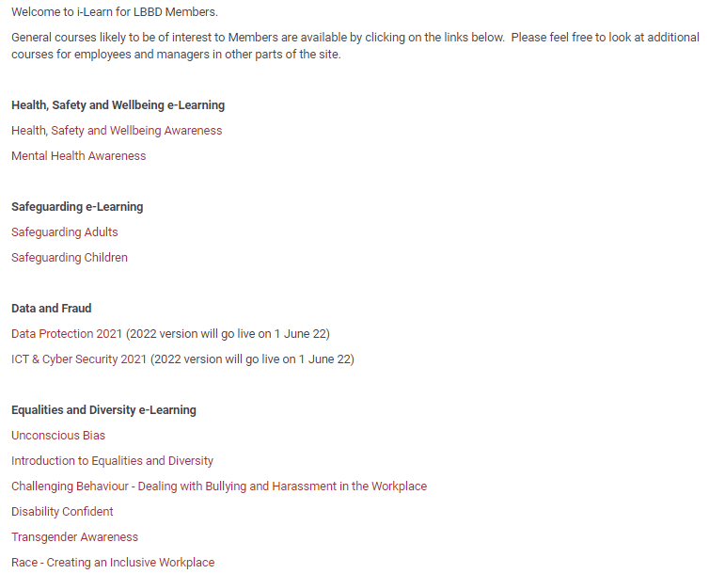
Notes:
In addition to the mandatory training, on the site you’ll find some other courses that you may specifically find useful

Slide 5
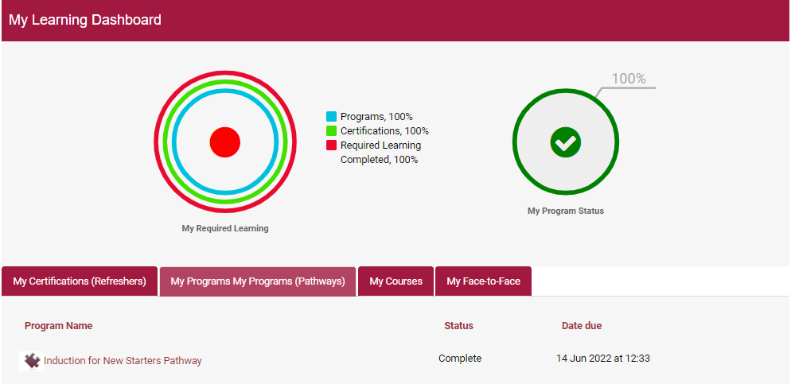
From 1st June you will be able to access information on the dashboard showing your progress
Your mandatory training window starts from 1 June (3 months to complete)
30 minutes for mental health awareness
1 ½ hours for Data Protection and ICT Cyber Security
Notes:
3 courses that are mandatory
Time limits
Deadline –
You’ll start getting email reminders towards the end of the deadline window
You can stop the course and restart it – so it becomes a bit more bite sized and easy to fit in – make sure you press save
Combination of video content, quizzes, tests, interactive as we can make it
ICT and Cyber Security – covers a wide range of subjects in short videos – including social media and privacy, phishing, using the web safely, and password security

Slide 6
At the top of the record on your home screen, you will see all the staff mandatory training courses, but scroll to the bottom to see the ones that you are enrolled onto and check your progress

Slide 7
Any Questions?

