Slide 1
Enforcement, Regulatory Services and Community Safety
Knife Crime Overview
Julia Kanji-Head of Regulatory Services

Slide 2
1
Knife Crime Data

Slide 3
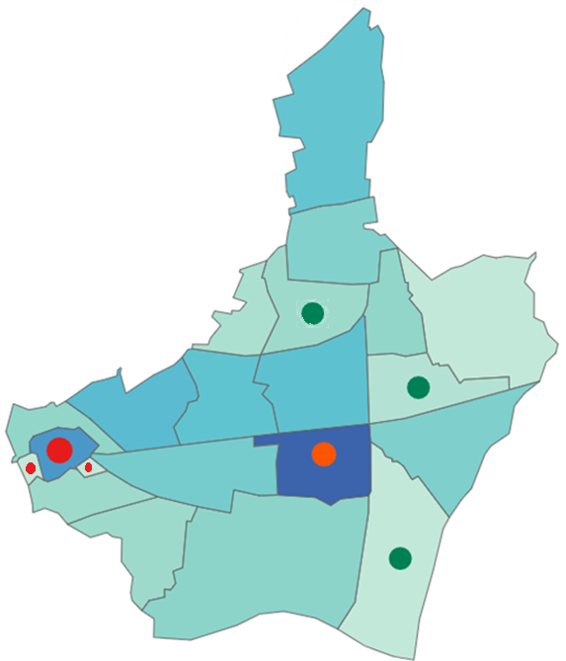
Knife Crime Data: Overview of last 12 Months
Knife Crime Offences Count:
535
12 months (ending August 2023) compared to previous 12 months (ending August 2022)
56.9%
Lowest offences recorded
Beam: 8 (Per 1000 pop: 0.9)
Alibon: 12(Per 1000 pop: 1.3)
2. Valence: 20 (Per 1000 pop: 1.4)
Highest offences recorded
1. Barking Town Centre: 56 (Per 1000 pop: 8.9)
2. Goresbrook: 64 (Per 1000 pop: 4.7)
3. Abbey: 8 (Per 1000 pop: 4.6)

Slide 4
2
Joint Funded Policing Team

Slide 5
Joint Hot Spot Patrols
CSEO JOINT PATROLS WITH POLICE | Jan-23 | Feb-23 | Mar-23 | Apr-23 | May-23 | Jun-23 | Jul-23 | Aug-23 | TOTAL
BARKING TOWN CENTRE | 2 | 5 | 9 | 7 | 5 | 3 | 5 | 2 | 38
HEATHWAY | 1 | 0 | 3 | 2 | 0 | 3 | 0 | 2 | 11
We are focused on improving our joint partnership work with the Police funded team, ensuring we are getting value for money for residents who fund the team and driving joint collaboration on priority issues.
There has notable improvements in tasking and partnership relations within the last month and a programme of outreach, enforcement, action days and joint targeted problem-solving operations are planned for the remainder of the year.

Slide 6
Joint Funded Policing Team
CRIME AND ENFORCEMENT TASKFORCE POLICE TEAM ACTIVITY FOR THE PAST 12 MONTHS LEADING UP TO AUGUST 2022
14 WEAPONS SWEEPS CARRIED OUT
3 WEAPONS SWEEPS UNDER `OP SCEPTRE`
OFFICERS ATTENDED TO 10 WEAPON /KNIFE RELATED `CAD` CALLS
8 VARIOUS TYPES OF KNIVES WERE RECOVERED
5 PEOPLE WERE ARRESTED FOR POSSESSION OF OFFENSIVE WEAPONS
1 WEAPONS SWEEP CONDUCTED
1 LARGE MACHETE, 1 KNIFE, 1 ZOMBIE KNIFE AND 1 STANLEY KNIFE WERE SEIZED
2 PEOPLE WERE ARRESTED FOR POSSESSION OF OFFENSIVE WEAPONS
MOST VISITED LOCATIONS: BARKING TOWN CENTRE, HEATHWAY, BECONTREE AREAS, PARSLOES AND GORESBROOK PARKS
PATTERNS: NO PEAK DAY OR PEAK TIME, NO PATTERNS OR REPEATED LOCATIONS WERE OBSERVED

Slide 7
3
Community Safety Enforcement Team

Slide 8
CSEO Patrols in Violence Focused Areas
PSPO Areas (Barking Town Centre, Heathway, Broad Street)
Parsloes Park
Central Park
Beam Park
Sunningdale Avenue
Ripple Road
Jute Court, Icehouse Court
London Road Car Park
Oxlow Lane
Wilmington Gardens
Cranleigh Gardens
Movers Lane
Oban House
Ibscott Close
Sandringham Road
Officers carried out 1306 patrols in ‘tasked’ areas Between January-August 2023
149 rough sleepers were directed to targeted support
30 flytipping occurrences were reported to relevant teams
36 people were seen taking drugs/smoking cannabis and moved on
4 Community Protection Notices were issued
1 Community Protection Warning was issued
ASB Warnings | Jan-23 | Feb-23 | Mar-23 | Apr-23 | May-23 | Jun-23 | Jul-23 | Aug-23 | TOTAL
Begging | 25 | 26 | 21 | 6 | 13 | 10 | 15 | 14 | 130
Drinking Alcohol | 8 | 16 | 15 | 8 | 18 | 8 | 11 | 15 | 99
Urinating | 15 | 1 | 1 | 0 | 2 | 0 | 1 | 2 | 22
Spitting | 7 | 5 | 1 | 1 | 0 | 2 | 0 | 0 | 16
VERBAL Warnings | Jan-23 | Feb-23 | Mar-23 | Apr-23 | May-23 | Jun-23 | Jul-23 | Aug-23 | TOTAL
Begging | 33 | 17 | 18 | 11 | 11 | 12 | 19 | 40 | 161
Drinking Alcohol | 48 | 1 | 46 | 70 | 52 | 72 | 70 | 73 | 432
Urinating | 2 | 2 | 0 | 0 | 0 | 0 | 0 | 2 | 6
Spitting | 17 | 3 | 1 | 2 | 0 | 0 | 1 | 0 | 24

Slide 9
4
STOP AND SEARCH, ENFORCEMENT, ENGAGEMENT AND OPERATIONS

Slide 10
Stop and Search
Year Aug 22 – Jul 23
Notes:
29% positive outcome. Out of which 68% are for drugs followed by 58% for weapons.

Slide 11
Stop and Search
Year Aug 22 – Jul 23
Notes:
29% positive outcome. Out of which 68% are for drugs followed by 58% for weapons.

Slide 12
Stop and search
Year Aug 22 – Jul 23
Notes:
29% positive outcome. Out of which 68% are for drugs followed by 58% for weapons.

Slide 13
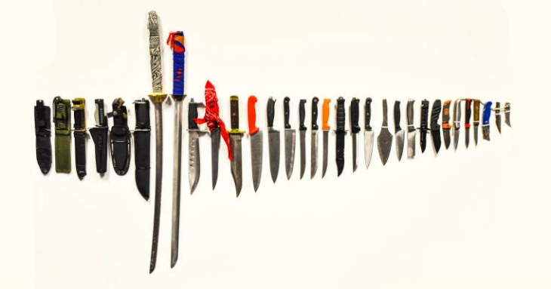
Enforcement and Engagement
#ChooseALifeNotAKnife
Review of tasking and coordination process with LA and partners-Fortnightly tasking and finish group with shared values and increased accountability.
Effective governance of stop and search through the CMG with 70% attendance. We have increased the membership to 7 which is more representative of the community in the borough as well as BWV viewings to increase greater accountability of the use of this tactic.
An officer from the safer schools team offers a one day workshop centred around knife crime. This is a full day
input and works in partnership with a charity and the London Ambulance Service who will also have an input on the day.
This workshop is designed for secondary school pupils, and is offered free to the schools to take up however
this is subject to the interest of the school. This workshop is designed to educate students around the topics which arise from carrying a knife and using a knife.
Engagement with Ben Kinsella Trust around raising the profile and tactics to prevent knife crime on the borough.
SNT conduct weapon sweeps and targeted patrols in hotspot areas which have been identified high in knife crime.
Numerous tactics have been applied to hotspot areas including
Plain clothes patrols – Targeting suspects involved in knife related crime
High visibility patrols – Deter and disrupt those involved in knife related crime
Operations at the train stations to disrupt those involved in knife crime related offences (Robbery)
Test purchasing is also being arranged to work with police cadets to disrupt the sale of knifes to children. Reducing the
opportunity for children to get access to a knife.
Notes:
29% positive outcome. Out of which 68% are for drugs followed by 58% for weapons.

Slide 14
Recent Operations:
#ChooseALifeNotAKnife
Op Snare-As part of the Summer Nights Active Robbery Engagement plan (Operation SNARE). Officers from Safer Neighbourhood Teams along with the Barking Town Centre Team and the VSU took part in a co-ordinated day of series of events to prevent, disrupt and reduce robbery and knife enabled crime. This included transport hubs to target offenders moving through the borough, along with other areas that had been identified with the use of crime mapping. Plain clothes officers were also deployed who were able to patrol locations and respond to incidents. A Weapon Sweep was also competed with the help of the Status Dog Unit.
Summer violence plan launched for summer period. This is MPS wide initiative previously used by the MPS in response to the seasonal increases in open space violence. There were a number of tactics deployed during the operational period including face to face engagements with communities; diversion activity; working with businesses to prevent crime; focused patrols in violent hotspots and enhanced activity to arrest wanted offenders
Notes:
29% positive outcome. Out of which 68% are for drugs followed by 58% for weapons.

Slide 15
5
Joint Day of Actions

Slide 16
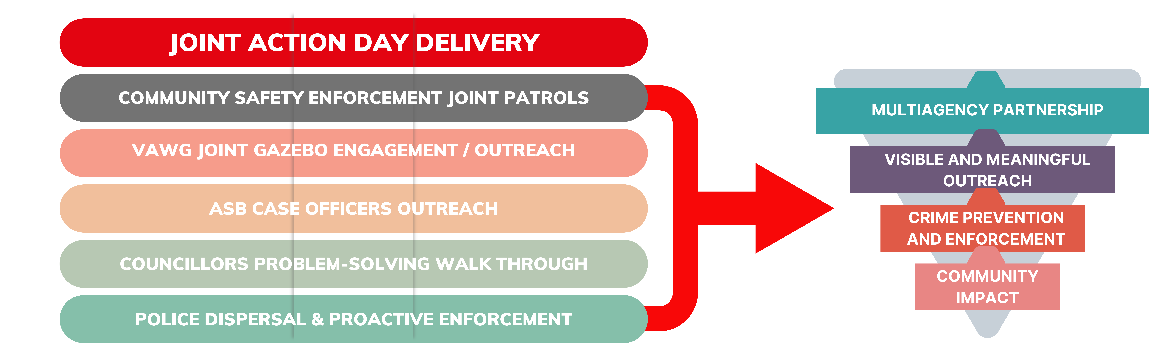
Joint Days of Action
Community Safety and Safer Neighbourhood Policing Teams are working in partnership to deliver regular and impactful joint days of action.
These events will involve a high visible enforcement delivery from both police and community safety enforcement officers, along with community engagement and outreach.
Regular planning of these events in partnership will be coordinated with additional Community Safety outreach events complementing these.

Slide 17
Day of Action - Heathway

Slide 18
Day of Action - Heathway
Joint day of actions focus on a wide range of areas but have a strong focus to deter knife crime and serious violence, in particularly within The Heathway and Barking Town Centre due to recent knife hotspots and a fatal stabbing.
This and the added community outreach forms part of our wider public health approach to knife crime and serious violence prevention.
28th June 23
Joint Day of Actions 2023
Wednesday 28th June 2023 | The Heathway
Wednesday 12th July 2023 | The Heathway
Friday 28th July 2023 | Barking Town Centre
Wednesday 9th August | The Heathway

Slide 19
6
Knife Crime Initiatives
Prevention, Engagement, Diversion

Slide 20
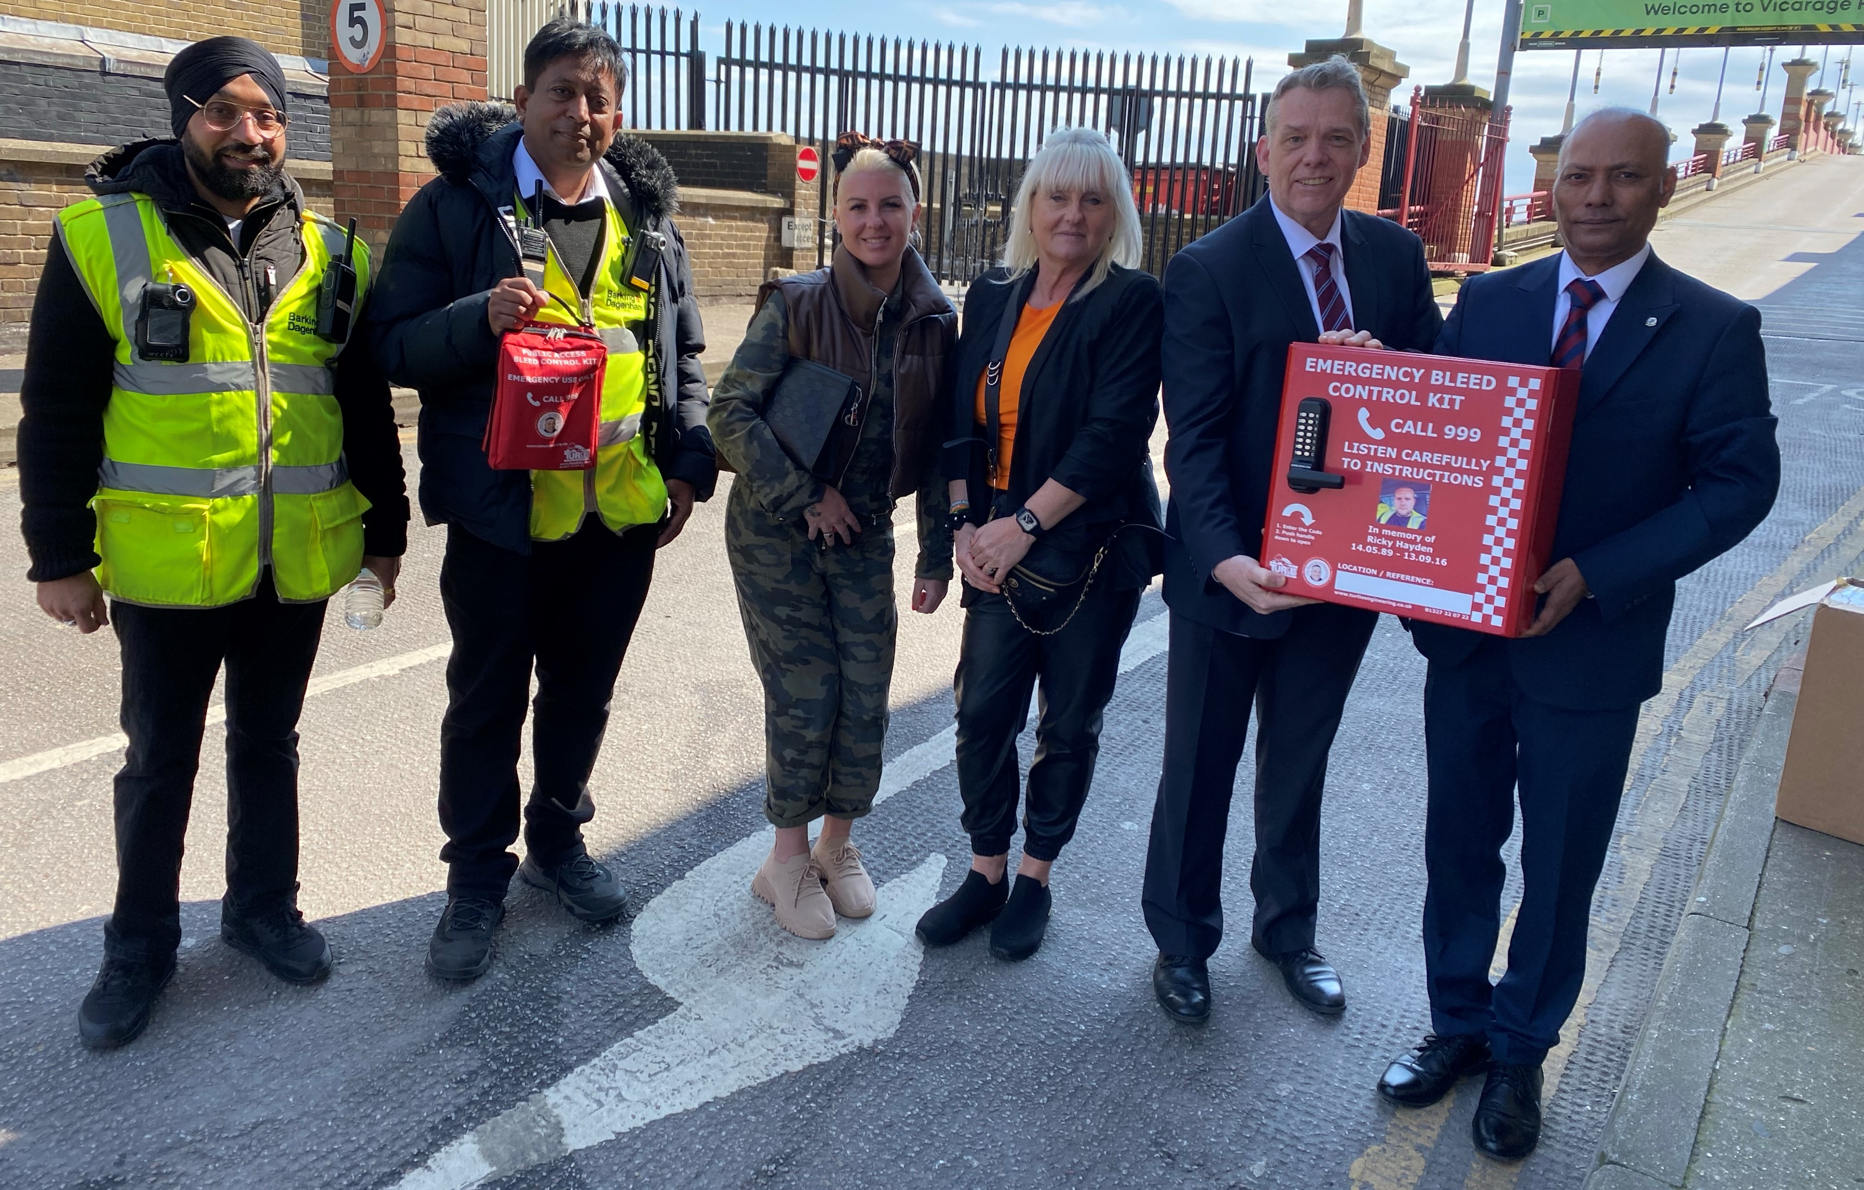
Ricky Hayden Blood Kits + Funding
Community Safety is working with the Ricky Hayden Memorial Trust initiative in publicly accessible major bleed kits to save lives and support initial emergency first aid to victims.
Following a successful Trading Standards Legal Settlement, the following funding has been distributed and allocated to support this wider initiative:
Street Doctor First Aid Funding for every Year 12 Pupil and Frontline Community Safety Enforcement Officers (£20,000).
8 Prometheus Wall Mounted Bleed Kit Boxes, 23 mobile bleed kits and 1 large rucksack kit for borough events (£25,000).
Two-year funding allocated to uplift the YARN with 2 x Youth Workers focusing on knife crime prevention (£100,000).
We are continuing to work with the Metropolitan Police to support Sue Hedges in getting the access codes shared across their call systems so these vital bags remain accessible and used to save lives.

Slide 21
Ending Gangs & Youth Violence (EGYV)
July 22 – July 23
ASB Gang Identified
Commissioning
Through EGYV governance the ‘ASB Gang’ was linked and confirmed to be a gang prior to the MPS even considering this group of young people to be a gang.
£80,000 has been used to commission a one-to-one mentoring provider for all young people identified at EGYV as being involved in serious youth violence or gang related activities.
COMMISSIONING OUTCOMES:
• Young people identified as being involved in serious youth violence or gang related activities are offered one to one mentoring to assist in diverting them from crime and into ETE.
• Engage with 40 children on a one-to-one intensive basis a year.
• 75% of children referred to the mentoring service are engaged in some form of ETE when contact is ended.
18 Young People
Referred to EGYV
EGYV drives early information sharing, partnership arrangements and best practice in driving early intervention and prevention of knife crime, serious violence and gang members. Ongoing improvements with police are ongoing in relation to information sharing and joint delivery.

Slide 22
Achilles Heel Tactics - Gangs / Serious Violence
Community Safety have been implementing early enforcement review and delivery, where possible, for incidents of serious violence, knife enabled crime and gang activity using well tested Achilles heel tactics.
Achilles heel tactics are enforcement that isn’t using the primary powers or legalisation in relation to the incident in question in order to remove harm and offenders from our communities.
An example has been a disorder incident occurs with knifes being threatened or used. When this is shared with the Community Safety Operations Department, the Anti-Social Behaviour team will work with Landlord Services / Tenancy Sustainment services to explore suitable opportunities to delivery alternative enforcement when justified and proportionate.
This may allow alternative enforcement to commence in parallel such as rent arrears or mandatory repossession grounds if the incident meets the legal criteria.
This is a new process for the service and ongoing development and improvements are being made to obtain early information from the police to allow this tactic to be reviewed and in suitable situations, deployed.

Slide 23
7
Trading Standards

Slide 24
Trading Standards
Trading Standards are focusing on several operations to prevent and mitigate knife enabled crime across the Borough, by the following key operations:
Operation Safe Seller Joint operation with the Police tackling the second-hand suppliers who may be enabling mobile phone theft.
Operation Blunt The project will firstly involve a Trading Standards led responsible retailer scheme which will allow traders to get endorsement from the Local Authority Trading Standards Team for the highest standards of responsible operating. The scheme will go further than similar statutory based schemes by requiring all sellers to be over the age of 18 (not currently a legal requirement) and empowering retailers to refuse the sale of a knife and to notify the police in circumstances where they have grave concerns about the purpose of such a sale.
Responsible Retailer Scheme Barking and Dagenham Trading Standards will continue to work with retailers to sign up to the MOPAC’s Responsible Retailer Scheme for knives, providing invaluable training and good practice on selling knives. There are currently 15 premises signed up to this scheme and work is ongoing to increase this.
Underage Knife Test Purchases – Summer of Action
Date
Area
Date | Area
Wednesday 26 July | Barking
Wednesday 9 August | Dagenham
Wednesday 23 August | Barking and Dagenham
TOTAL PASS TESTS 22 | TOTAL FAILED TESTS 3

Slide 25
Robbery Taskforce & Lost Hours
Robbery Group is established and chaired at Director level, with key members being SLT members across East Area BCU and partners.
The Robbery Group are currently reviewing how best to infuse the LBBD Lost Hours Campaign into Community Safety outreach and engagement with young people and parents.
Community Safety are working in partnership to support police to prevent and apprehend robbery offenders within the golden hour principle. We have agreed to fund two iPads for Barking and Dagenham officers to locate stolen mobile phones in realtime.
Robbery is a key crime trend to tackle knife possession and enabled criminality as we know the data currently shows this is a regular theme for this crime type that has increased across the borough.
Additional commissioning is being explored via the Robbery Group in order to focus on places and people simultaneously.

Slide 26
Knife Crime Commissioning-Mopac Funded
£113,000
The delivery of workshops targeted at the reduction of knife crime to 2750 young people, to give support and intervention focused on diverting young people away from knife crime.
£80,000
The delivery of mentoring provision to children and young people and young adults identified through the Youth Offending Service (YOS) and the Ending Gang and Youth Violence (EGYV) panel.
£49,600
LBBD can create and shape focused questions so that targeted work around high harm crimes like serious violence and robbery can be delivered.
Provides insights on concern areas and key data on where violence, knife crime and gang activities are currently perceived.
£66,700
Outreach youth work, engaging young people where they are and signposting them to existing services, within the borough, particularly during the ‘lost hours’ and throughout school holidays.
£80,000
Joint commissioning with London Borough of Redbridge with Box Up Crime to deliver detached outreach work tackle cross-borough serious violence issues.

Slide 27
8
Thank You

