Slide 1
Chairing Skills Barking and Dagenham Council Member Induction

Slide 2
Bethan Evans Presenter
 | 35+ years’ experience advising local authorities on governance, decision making, standards, probity and new ways of working

Slide 3
Purpose of the session
To explore the role of a Chair at different meetings
To ensure confidence in chairing effective meetings
To review the required skills and approaches
To look at actions before, during and after meetings

Slide 4
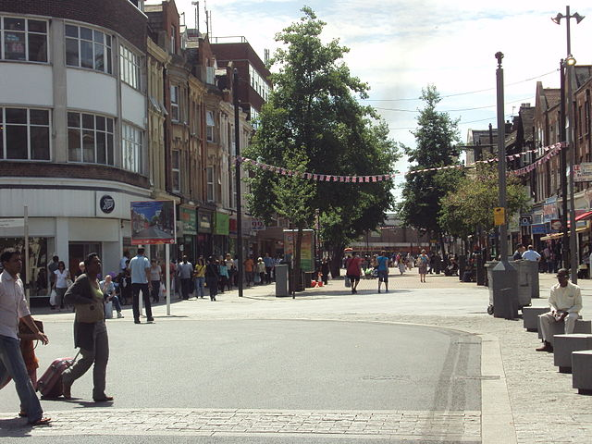
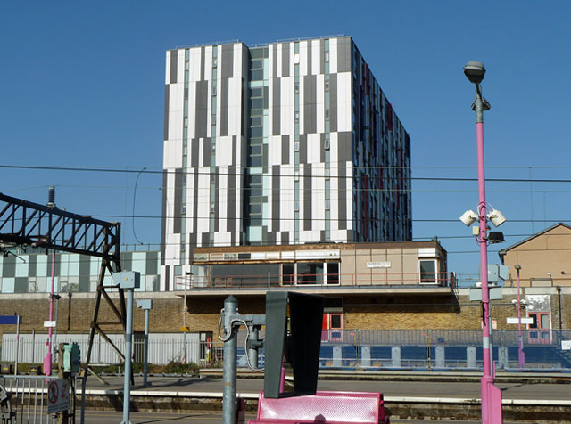
Relevant to you all, whether you are an experienced Chair or not!

Slide 5
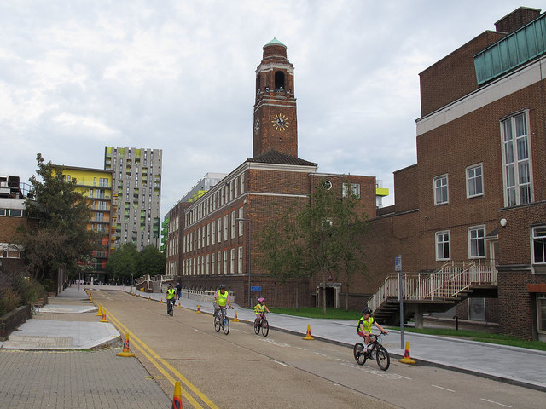
The Role of a meeting Chair at the council

Slide 7
A good chair helps the meeting to run smoothly and efficiently.
They will make sure that:
all the business is discussed
everyone’s views are heard
clear decisions are reached
the meeting starts and finishes on time
The Resource Centre – advice for Community Groups

Slide 8
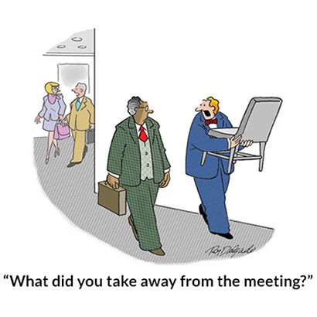

Slide 9
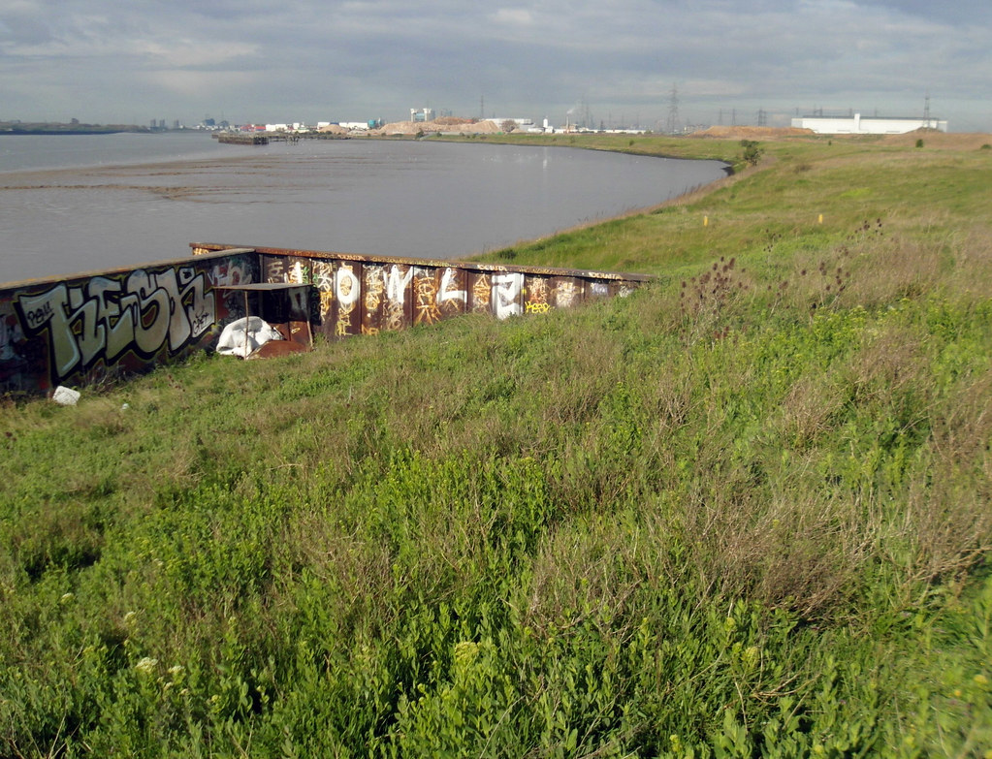
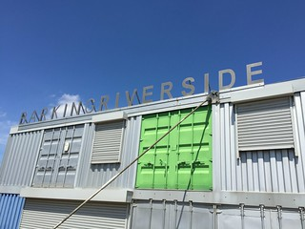
Your experience of chairing meetings?

Slide 10
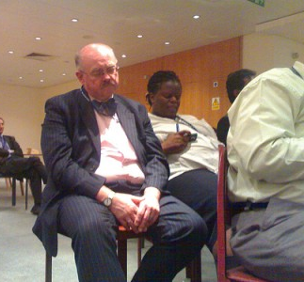
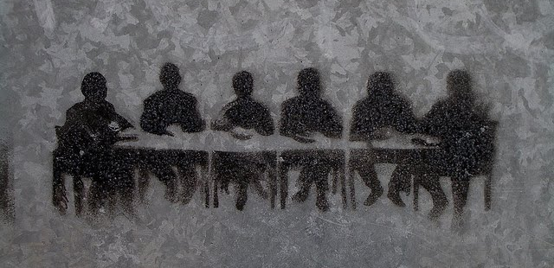
Losing the will to live?

Slide 11
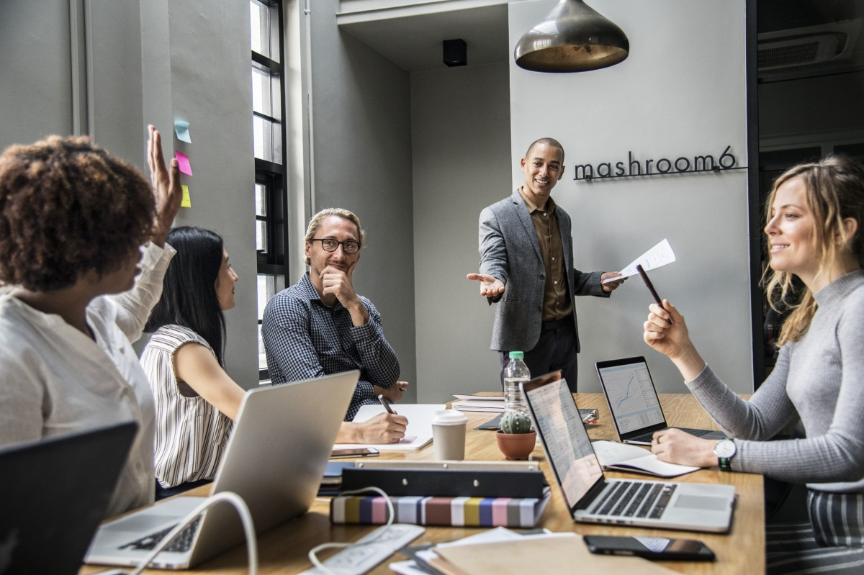
Engaged and inspired?

Slide 12
LGA - why is a good Chair important?
Provides for clear leadership and direction
Ensures debates are focused and balanced
Enables decisions to be reached
Contributes to group/team working
Ensures resources are used to best effect

Slide 13
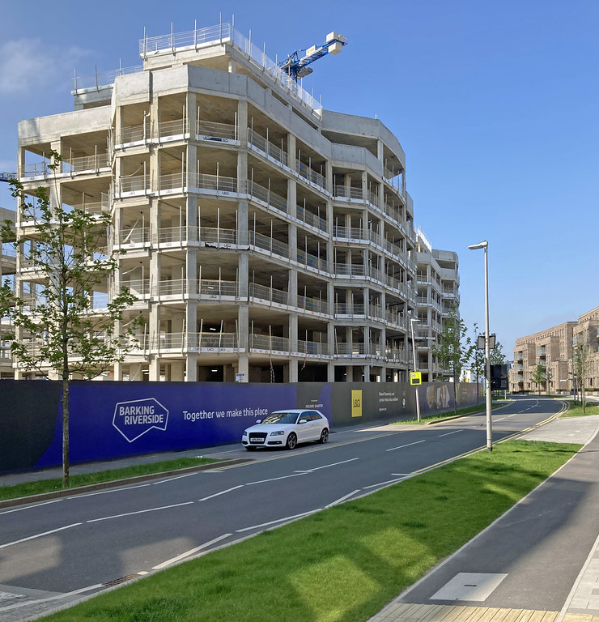
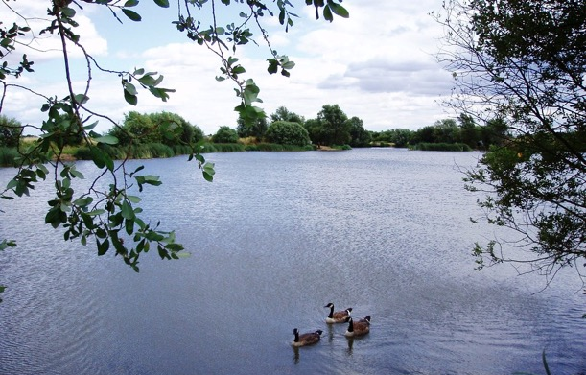
What do you think is the biggest challenge to being an effective Chair of a meeting?

Slide 14
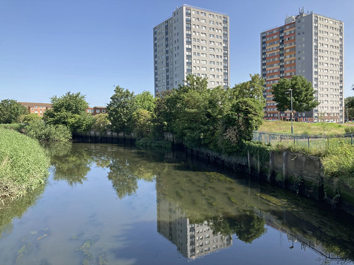
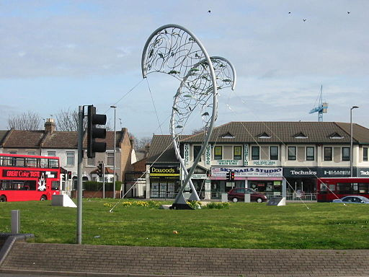
The Legal Framework for Meetings

Slide 15
Legal framework
Local Government Acts and Regulations
Your Constitution
Other relevant law e.g defamation, public order

Slide 16
Key aspects for a Chair to understand
Procedural rules and voting
Powers of the Chair
Behaviour and conduct

Slide 17
You have no authority here Jackie Weaver!
Read the standing orders, READ THEM AND UNDERSTAND THEM!

Slide 18
Rules of debate
Motions, seconding and debate
Amendments to motions
Points of order/personal explanation
Voting

Slide 19
Amendments to motions
Amendments must be relevant to the motion
Can refer the matter to another body or
Leave out, replace or insert words.
As long as (1) the motion is not negated and (2) the amendment is compatible with previous decisions

Slide 20
Key powers of a Chair
Has a second or casting vote to decide tied votes
Can add urgent items to the agenda of a meeting
Can make a final ruling on points of order and personal explanations
Can make a ruling on closure motions
Power to deal with disorderly conduct

Slide 21
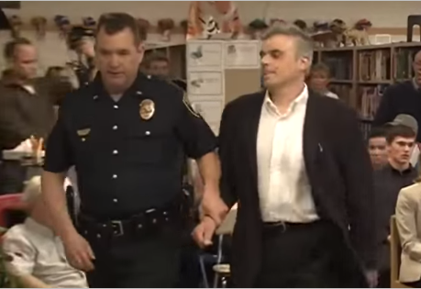
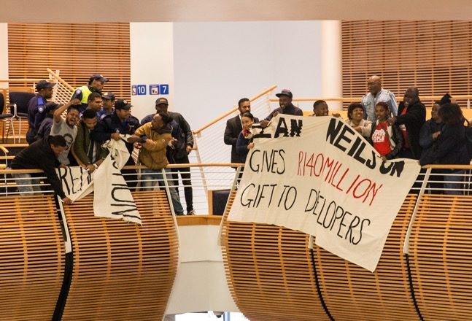
Conduct at meetings

Slide 22
Conduct at meetings
Member behaviour – code of conduct and protocols
Public disorder
Powers of the Chair

Slide 23
Keeping Order
Request
Warn
Order Removal
Adjourn Meeting

Slide 24
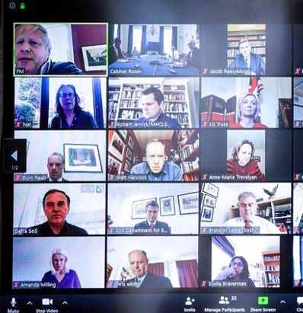
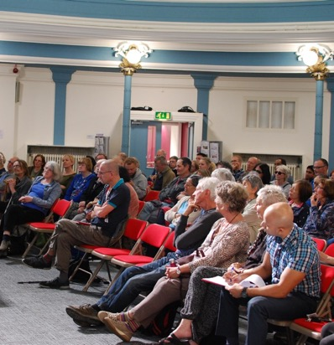
Different types of meetings

Slide 25
Different chairing roles
Ceremonial Council
The Assembly
Quasi judicial committees
The Cabinet
Overview and Scrutiny committee
Other committees

Slide 26
Different approaches at different meetings
Different levels of formality/procedures
Different objectives/outcomes
Involvement of public/other organisations
Different risks of challenge to decisions

Slide 27
The Assembly
Shop window for the Council
Responsible for budget and policy framework
Constitution/standing orders applied strictly
Preparation, preparation, preparation

Slide 28
The Executive
Chaired by the Leader
Responsible for making decisions on executive functions
Open to challenge by scrutiny

Slide 29
Statutory Guidance on Overview and Scrutiny - the Chair’s Role
Responsible for scrutiny’s profile, influence and ways of working
Needs an ability to lead and build a sense of teamwork and consensus
Needs to guard the committee’s “independence”

Slide 30
Quasi-judicial meetings
Decisions being made about people’s lives and livelihoods – high stakes
Ensure appropriate participation
High potential for challenge so adhere to procedures
Watch declarations of interest and issues of bias or predetermination
Take officer advice
Be absolutely clear on decisions made and the reasons

Slide 31
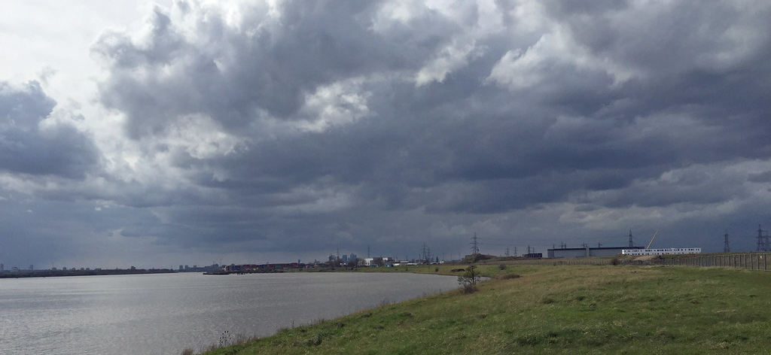
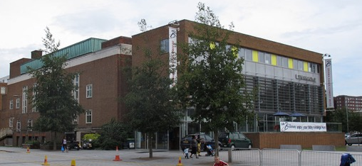
Skills and approaches needed to be an effective Chair

Slide 32
A useful and practical resource tool for all councillors

Slide 33
LGA – top tips for effective Chairs
Know the issues and topics
Understand the meeting participants
Know the procedures – standing orders
Build support/rapport outside meetings

Slide 34
Tips for leading a meeting effectively – The Leadership Lab
Be ready, organized and prompt
Be productive and focused
Be serious
Be confident
Be fair and inclusive

Slide 35
Facilitating and questioning skills as a Chair
Questioning, including different approaches – open, leading, summarising questions etc
Formulating recommendations – what exactly are you saying and what should now happen
Drawing conclusions from evidence and answers to questions

Slide 36
Choosing the right question
Closed questions
Single word (or very short) answers
Good for checking out your understanding, concluding a discussion
Don’t use too early – can kill the conversation
Open questions
What, why, how, tell me, describe……
Good for developing a conversation, finding out more details and finding out views

Slide 37
Useful questions to use
You sound as if ……….
I get the feeling that ……
Are you saying that …………..
Can you tell me more about ……..
Imagine if …………….
How else could ………
How does that compare with ……
What would it take to ……….

Slide 38
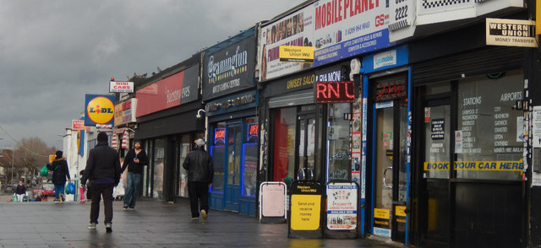
Good to avoid saying!
With the greatest respect…..
I’m not being funny but……
Don’t take it personally……
I’m not having a go at you but…….

Slide 39
Practicalities
Before
During
After

Slide 40
Before the meeting
Agenda planning meeting – important part of the process
Think about the agenda and the draft reports – is the business manageable?
Touching base with officers/members/participants

Slide 41
At the meeting
Remember your focus – managing the business
Think about your “audience” – members, officers, partners and the public
Reflect on your tone - appropriate authority, inclusion and fairness

Slide 42
After the meeting
What went well/what can we learn and do better next time
Thinking ahead to the next meeting
Thanks to contributors
Minutes and actions

Slide 43
Handling people in meetings
People who are deliberately disruptive or rude
People who stay silent
People who want to contribute but who are clearly nervous
People who contribute but can’t stick to the point

Slide 44
People in meetings
The disruptors
The non-contributors
The show-offs
The ramblers
The distracted

Slide 46
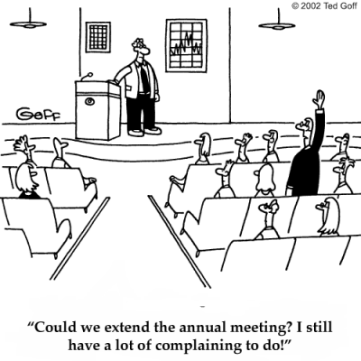

Slide 47
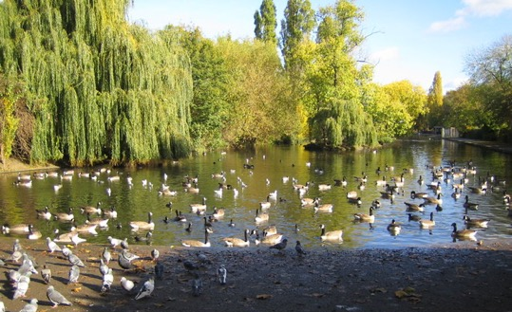
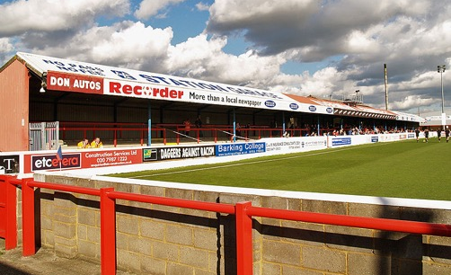
Mini scenarios – what would you do?!

Slide 48
You are going to chair a meeting which will be considering a very contentious issue. There will be a lot of members of the public present and a number of people will be making public statements, asking questions and submitting petitions, all about the same issue. You are concerned (1) that people are going to run over their allotted time and (2) the debate is going to get very heated. How do you approach this meeting? What would you do in advance? What would you do on the day?

Slide 49
You chair a meeting where a number of the members tend to hog the proceedings. They are experienced members who are very confident and make a good contribution so you don’t want to discourage them.
But you have noticed that other, newer, members of the meeting don’t speak up and seem happy to let the others do the work.
What would you do in your role as Chair?

Slide 50
You are at a pre-agenda meeting for a meeting. The planned agenda for the next meeting contains 10 items, a number of which are substantive and contentious issues. One of the other members is also insisting that officers prepare an urgent report on an issue which has just arisen and add this to the agenda.
You are really concerned that (1) the agenda is unmanageable and (2) officers will not be able to produce a high quality report on the urgent matter in the time available.
How would you handle this?

Slide 51
There is an item on the agenda for your next meeting. It relates to a topic which you personally feel very strongly about, and you really want to get your views across to the other members. You are not sure how best to approach it given your role as Chair. You think that you might allow the debate to run for a little while and get all the issues on the table; but you also wonder if it might be better to get your views in first, so that everyone knows how you are going to be voting. How would you approach this?

Slide 52
Questions and close

